Slide 1


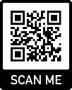
Protocol Deviations
EVIS Training Video
Version 2.0 5th February 2025
Warning: This training video is version controlled. Printed or download copies may not be the current version. See www.evis.scot.nhs.uk

Slide 2

What are Protocol Deviations ?
Why document them ?
Forms
Categorisation of deviations
Examples
Contact Information

Slide 3

What is a Protocol Deviation ?
Protocol non-compliance
Are departures from the protocol that have been identified retrospectively (Impossible to predict and at times inevitable)
Deviation – a minor departure from the protocol e.g. a missed visit window.
Violation – a major departure from the protocol e.g. patient ineligible.
Trial non-compliance
Failure to comply with
The protocol (protocol deviation/non-compliance)
GCP
Regulations or Acts of Parliament
For all non-compliances
Establish root cause
Implement corrective and preventative measures
SI2004/1031
Version 2.0 5th February 2025 SOP 51.008 Handling non- compliances
Notes:
Minor – no compromising of data or safety
Major - compromising of date and/or safety

Slide 4
Why document them ?
“A sponsor of a clinical trial should list all significant protocol non-compliances/deviations in the clinical study report or publication, and must assess whether any of these non-compliances should be reported to the MHRA as a serious breach of GCP and the protocol.” MHRA GCP Guide
The sponsor must ensure
There is a process for defining non-compliances for a trial, including their classification (such as major or minor).
There is management and escalation of non-compliances, including corrective and preventative actions.
Version 2.0 5th February 2025

Slide 5
Forms
Forms
Protocol Deviation Reporting Log Form 51.008C (Site to complete): We use this form for Category 1 and Category 2 deviations
Protocol Deviation Reporting Form 51.008A (Site/trial team to complete) We use this form for category 3 and category 4. If the Sponsor requires more information on a deviation, we may ask for you to complete this form.
Protocol Deviation Reporting Form (part 2) 51.008B (Sponsor to complete)
Version 2.0 5th February 2025
Notes:
Looking for CA/PA

Slide 6
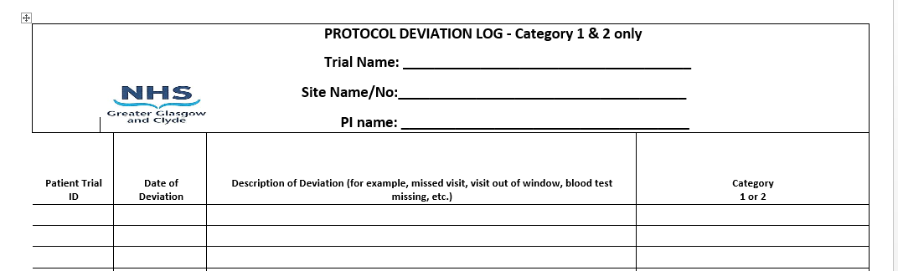
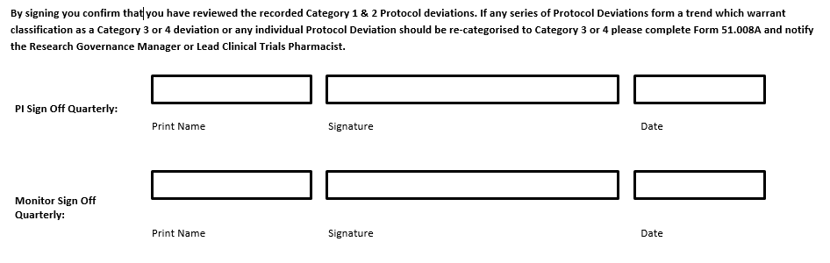
Form 51.008C :Send Monthly

Slide 7
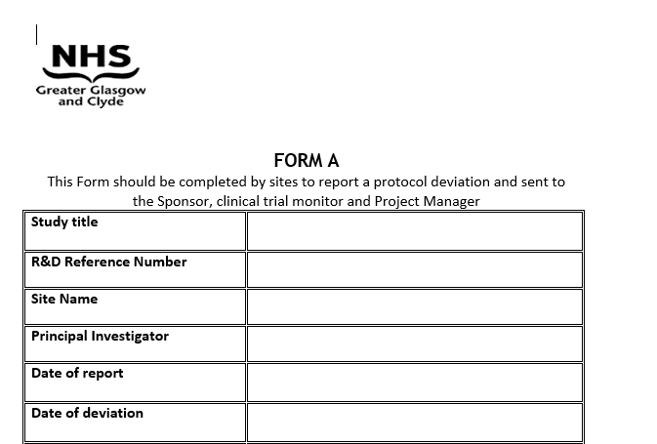
FORM 51.008A

Slide 8
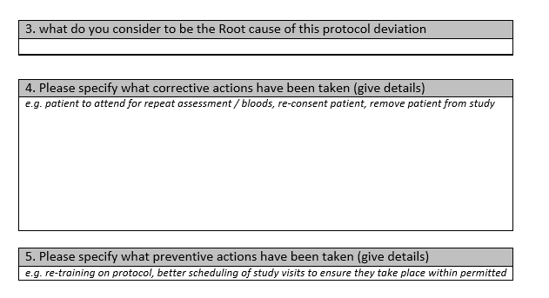
CAPA :Corrective and Preventative Actions
5. Please specify what preventive actions have been taken (give details)

Slide 9
Categorisation of deviations
Monitor’s categorisation of deviation
Category 1: Minor issues detected
Minor issues of non-compliance of an administrative or technical nature are detected that do not compromise patient safety or the integrity of the trial data
Category 2: Major issues detected
Major issues are detected that could affect the conduct of the trial but do not constitute a serious breach of GCP of the protocol
Category 3: Serious issues detected
Serious issues are detected that may impact on patient safety and/or integrity of the data. This may include potential serious breaches of GCP and/or the trial protocol
Category 4: Critical issues detected
Critical issues are detected that have a significant and/or immediate impact on patient safety and/or integrity of the data. This may include potential serious breaches of GCP and/or the protocol

Slide 10
Examples
EQ-5D-5L not being filled in – Category 1
Data Point that affects outcome data – Category 2
Patient does not meet eligibility – Category 3
Multiple patients do not meet the eligibility – Category 4
Notes:
Deviation 1

Slide 11
Protocol Deviation Flow Chart
Protocol Deviation Identified
Report to monitor/sponsor team
Monitor will help to instruct which category of deviation and confirm which form to complete
Site to complete form and return to monitor.
Once CAPA completed, monitor will send Form A and B to site for filing.
If CAPA required, monitor will instruct site

Slide 12
Contact Us
ggc.randd.monitoringgroup@nhs.scot
Emma.Moody@nhs.scot

