Slide 1



EVIS: Overview for pharmacy staff
EVIS Training Module 11
Version: 4.0 23.01.2025
Study: EVIS – Early Vasopressors in Sepsis EudraCT: 2021-006886-39
Chief Investigator: Dr Alasdair Corfield Sponsor: NHS Greater Glasgow & Clyde
Warning: This training module is version controlled. Printed or download copies may not be the current version. See www.evis.scot.nhs.uk

Slide 2
Who should view this module?
Aim: To provide pharmacy staff with relevant information on the EVIS study
Target audience:
Pharmacy clinical trials staff
Other pharmacy staff such as clinical pharmacists and ward based technical staff

Slide 3
Contacts
EVIS project manager: Hannah Greenwood
Hannah.Greenwood@nhs.scot
ggc.evistrial@nhs.scot
Pharmacy contact: Elizabeth Douglas/Pamela Surtees Pharmacist/Pharmacy Technician
NHS Greater Glasgow & Clyde
elizabeth.douglas5@nhs.scot
pamela.surtees@nhs.scot
R&I contact: Louise Ner Louise.Ner@nhs.scot
Chief Investigator: Dr Alasdair Corfield
alasdair.corfield2@nhs.scot

Slide 4

This module covers:
Study background and overview
IMPs and IMP management requirements
Site initiation process
Potential risks and mitigation strategies in EVIS
Pharmacy roles in EVIS

Slide 5
EVIS Study
Background and Overview

Slide 6


Who is leading EVIS?
EVIS: Early Vasopressors in Sepsis
EVIS is an academic clinical trial funded by the UK National Institute for Health Research
Chief Investigator, is Dr Alasdair Corfield, a Consultant In Emergency Medicine in Glasgow
Phase 3, open label, two arm, multi-centre pragmatic, randomised trial
Sponsor: NHS Greater Glasgow and Clyde
Notes:
05/02/2025
History V1.0 2010
6

Slide 7
Why is the EVIS study needed? (1)
Sepsis occurs when there is an overwhelming reaction to infection leading to life-threatening organ dysfunction
It remains a significant health priority in the UK
Estimated at least 245,000 cases in the UK each year of which approximately 20% of patients will die
Survivors often suffer life changing after-effects
Notes:
05/02/2025
History V1.0 2010
7

Slide 8
Why is the EVIS study needed? (2)
There’s a large amount of evidence to guide sepsis treatment beyond the first 8 hours but much less during early sepsis treatment – the resuscitation phase
Resuscitation phase: Current UK practice is generally to administer IV fluids and intermittent vasopressor boluses (if required) to maintain Mean Arterial Pressure (MAP) before starting continuous vasopressor infusion (via a central line) in ICU
Evidence base in resuscitation phase:
  Not clear if patients given a higher volume of IV fluids have increased mortality compared to those managed more conservatively
  An alternative approach would be to immediately start vasopressors to maintain blood pressure but without requiring prior IV fluids
Notes:
05/02/2025
History V1.0 2010
8

Slide 9

Why is the EVIS study needed? (3)
Main barriers to adopting a low IV fluid volume approach in the resuscitation phase is that traditionally vasopressors are given via a central line
Perceived risks to peripheral vasopressors are:
  risk of extravasation and/or
  interruptions to infusions
BUT risk of extravasation from peripheral vasopressor infusion is approximately 3%
Notes:
05/02/2025
History V1.0 2010
9

Slide 10
What will the EVIS study investigate?
EVIS will investigate if early peripheral vasopressor infusion targeted to MAP ≥ 65 mmHg in the first 48 hours of treatment improves clinical effectiveness in hospitalised adult patients with septic shock compared with usual care
Patients will be randomised to either:
  Intervention arm/Early peripheral vasopressor: peripheral intravenous norepinephrine
  Usual Care: peripheral intravenous fluid using a balanced crystalloid i.e. compound sodium lactate (also known as Ringers Lactate or Hartmanns solution) OR Plasma-Lyte 148 (pH 7.4) solution for infusion
All other care as per current UK/local sepsis guidance
Notes:
05/02/2025
History V1.0 2010
10

Slide 11
Key inclusion/exclusion criteria
Main inclusion criteria
  Age > 18 years
  Clinically suspected or proven infection resulting in a principal reason for acute illness
  SBP <90mmHg or MAP <65mmHg
  Measured serum lactate >2mmol/L at the time of eligibility assessment
  Hospital presentation within last 12 hours
Main exclusion criteria
  >1500ml of intravenous fluid prior to screening
  Immediate (<1 hour) requirement for central venous access or surgery
  Known allergy/adverse reaction to norepinephrine
  Pregnancy
See current protocol for full inclusion and exclusion criteria
Notes:
05/02/2025
History V1.0 2010
11

Slide 12
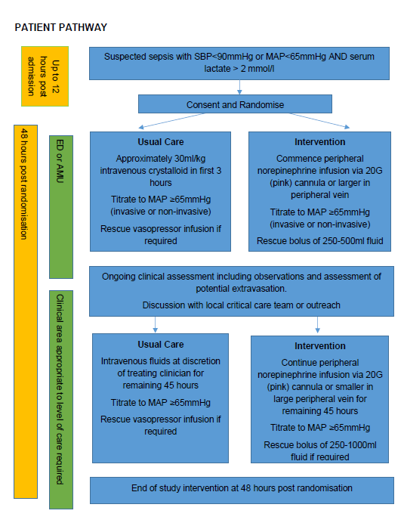
Who will do what in EVIS?
Activities limited to trained research staff Activities include:
Consent
Randomisation
Prescription of study medicine
Treating clinicians and nursing staff roles limited to:
Clinical need for maintenance and rescue treatment(s)
Preparation and administration of peripheral norepinephrine
Notes:
05/02/2025
History V1.0 2010
12

Slide 13
EVIS Study
Dosing, IMP management requirements and prescribing requirements
See current Protocol and IMP Manual for Sites for detailed information

Slide 14
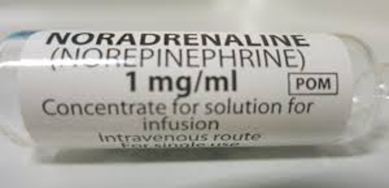
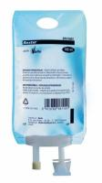
EVIS IMPs
Participants randomised to either:
  Intervention arm: Peripheral vasopressor infusion with norepinephrine
  OR
  Usual care (control) arm: Balanced crystalloid fluids
Other information
  All IMPs taken from hospital own stock. Not brand/manufacturer specific. Any products with UK license can be used
  No trial specific labelling dictated. Label as per local SOPs – optional labels available
  In the event that a drug alert/recall is issued for any of the IMPs action as per alert/recall and local procedures.
Notes:
05/02/2025
History V1.0 2010
14

Slide 15
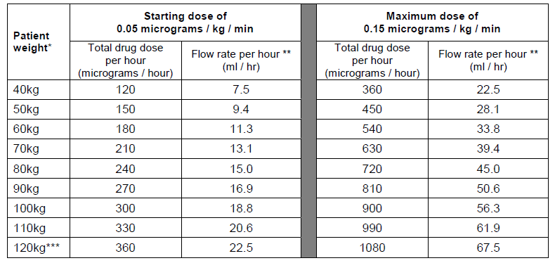
Peripheral norepinephrine: Dose table
(Intervention arm: assuming final norepinephrine concentration of 16 micrograms/ml)
  Norepinephrine dose: Target to MAP ≥ 65 mmHg
Key:
* Round to nearest 10 kg for dosing
* * Round to nearest whole ml if pumps cannot accommodate 1 decimal place
* * * Calculate to exact kg for weights above 120kg. Further information in protocol.
Notes:
05/02/2025
History V1.0 2010
15

Slide 16
Peripheral norepinephrine: Dosing info
(Intervention arm)
Study treatment duration: Up to 48 hours from time of randomisation
Route of administration: peripheral venous cannula
Preparation: solution containing norepinephrine 16 micrograms/ml
Diluent: 0.9% sodium chloride or 5% glucose
Other peripheral vasopressors: Patients in this arm should not receive any other peripheral vasopressor infusion during the 48 hour treatment duration
Dose up and down up-titrations
  Guidance in protocol but check with research team as local policy can be used
  If target MAP ≥ 65mmHg achieved immediately post-randomisation initial infusion rate must be zero. Rate can be increased at any point during 48 hour study period.
Notes:
05/02/2025
History V1.0 2010
16

Slide 17
Peripheral norepinephrine: Preparation (1)
(Intervention arm)
Preparation: Must use Norepinephrine 1mg/ml concentrate for solution for infusion
Concentration: Prepared infusion should contain Norepinephrine 16 micrograms/ml
Expiry: Assign as per SmPC/local practice
To prepare 250ml infusion containing norepinephrine 16 micrograms/ml
1 x 4ml ampoule norepinephrine 1mg/ml concentrate for solution for infusion
1 x 250ml infusion bag of 5% glucose or 0.9% sodium chloride
To prepare 500ml infusion containing norepinephrine 16 micrograms/ml
1 x 8ml ampoule norepinephrine 1mg/ml concentrate for solution for infusion
1 x 500ml infusion bag of 5% glucose or 0.9% sodium chloride
Notes:
05/02/2025
History V1.0 2010
17

Slide 18
Usual care (Control Arm)
Only the following balanced crystalloids are permitted:
  Compound sodium lactate solution for infusion. (Also known as Ringers lactate solution or Hartmann’s)
  Plasma-lyte® 148 (pH 7.4) solution for infusion
Dose: targeted to MAP ≥ 65 mmHg
Route of administration: peripheral venous cannula
Anticipate most patients will receive approximately 30ml/kg within first 3 hours using 250-1000ml rapid infusion (bolus). Thereafter, further crystalloid boluses for resuscitation as required.
Notes:
05/02/2025
History V1.0 2010
18

Slide 19
Concomitant medicines
Concomitant medicines
  No prohibited medicines
  Caution/co-administration not recommended with a number of medicines due to risk of severe, prolonged hypertension and possible arrhythmias (see protocol)
  See current protocol for detailed information
Notes:
05/02/2025
History V1.0 2010
19

Slide 20
IMP storage requirements
Storage of IMPs in clinical areas
  Store as per SmPC
  No sponsor requirement for IMP temperature monitoring – follow local SOPs
  In the event of a temperature excursion site responsible for resolution but inform sponsor if any potential patient safety issues
  Anticipate IMPs held as stock and routinely used in sepsis so no additional risks compared to standard care
Notes:
05/02/2025
History V1.0 2010
20

Slide 21
IMP accountability
No sponsor accountability requirements
Site required to prepare Source Data Plan detailing how study data will be recorded.
Template Peripheral norepinephrine Preparation & Administration Record is available and can be modified for local use
Disposal – as per local SOPs
Notes:
05/02/2025
History V1.0 2010
21

Slide 22

Prescribing IMPs (1)
No sponsor study specific prescription provided - prescribe as per usual practice/local agreed EVIS process.
Only trained investigators delegated responsibility on site delegation log to initiate and prescribe study IMPs
Intervention Arm: Must be prescribed by trained investigator. Write prescription to allow dosing in line with protocol requirements including temporary stop/restart of infusion as per protocol until the end of the 48 hour treatment period.
Subsequent prescriptions for control arm: Balanced crystalloids are used in accordance with routine care so if necessary, subsequent prescriptions can be prescribed by treating clinicians as per usual practice
Where available consider adding details in electronic prescribing systems to highlight EVIS patients and provide key information on use and administration of IMPs
Notes:
05/02/2025
History V1.0 2010
22

Slide 23
Prescribing IMPs (2)
Must be clear that patient is participating in the EVIS Clinical Trial
Norepinephrine and noradrenaline are both British Approved Names – prescribing should be consistent and in terms least likely to cause confusion
In the event an EVIS patient moves from one clinical area to another with different prescribing systems then acceptable for IMP prescription to be transcribed by someone other than trained investigator. However this should be clearly documented and performed in accordance with local procedures
Norepinephrine doses in EVIS are expressed solely in terms of norepinephrine base
Notes:
05/02/2025
History V1.0 2010
23

Slide 24
EVIS Study
Pharmacy initiation and training requirements

Slide 25
EVIS site initiation
Plan: one site initiation meeting held remotely via TEAMs
Pharmacy staff identified by local site team should automatically receive an invite to site initiation meeting
Other pharmacy staff such as clinical pharmacists are very welcome to join – please let the project manager know as it helps with the paperwork
Notes:
05/02/2025
History V1.0 2010
25

Slide 26
What about pharmacy initiation?
No plans to provide separate pharmacy staff initiation meeting
Why?
  Pharmacy related issues most likely to arise are best discussed with the research team as part of the main site initiation meeting
  IMPs are all from hospital own stock and no need to ring-fence
  Due to emergency nature of EVIS all IMPs need to be stored in the clinical area and expected that IMPs will already be held as stock in clinical areas that will care for EVIS participants
Notes:
05/02/2025
History V1.0 2010
26

Slide 27
What about a pharmacy site file?
A pharmacy site file will not be provided by sponsor, but sites should follow their own local SOPs in this respect
Anticipate that Study Monitor will only review the investigator site file
EVIS protocol and supporting documents will be available on the EVIS website. See www.evis.scot.nhs.uk or scan the QRS code
Notes:
05/02/2025
History V1.0 2010
27

Slide 28
EVIS Study
Risk management

Slide 29
Potential risks in EVIS study
As with any CTIMP there are potential risks
EVIS is an emergency care type study which brings its own risks and challenges
Potential risks in EVIS
  norepinephrine administered via peripheral and central IV routes in same clinical area
  Risk of preparation and administration errors as different concentrations of norepinephrine required depending on intended administration
  The study treatment period is up to 48 hours and multiple staff could be involved in the participant’s care during that time. Not realistic to have all staff fully trained in the trial protocol and delegated tasks. Treating Clinicians and those preparing and administering EVIS IMPs are not required to be on the site delegation or training log as these tasks whilst study specific, are within the normal remit and clinical responsibility of clinical staff
  Prescribing of the IMPs still needs to be limited to those who are trained and delegated that responsibility on the site delegation log
Notes:
05/02/2025
History V1.0 2010
29

Slide 30
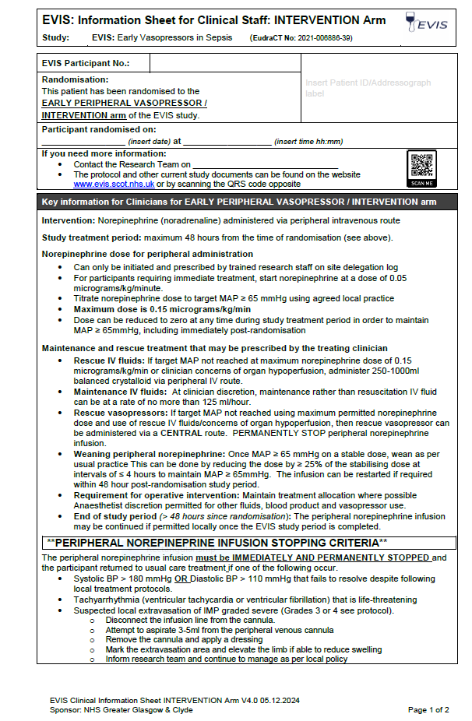
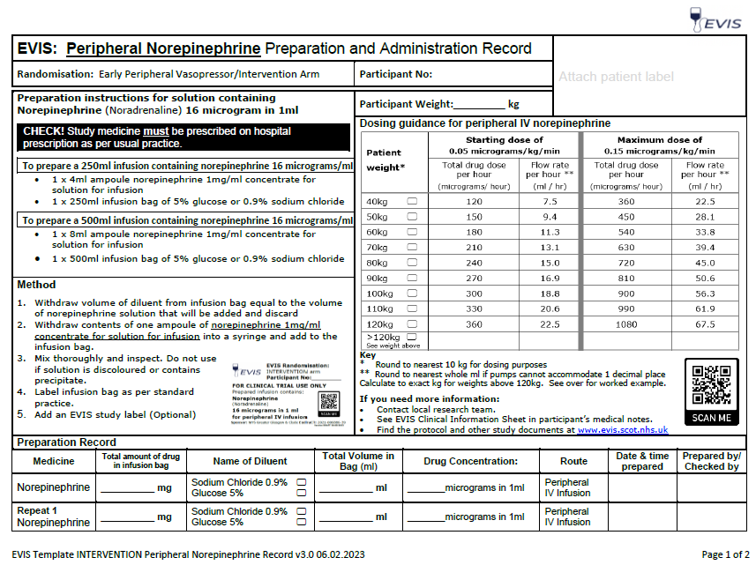
Risk mitigation for EVIS
Site initiation training: to include pharmacy staff
Training modules and study documentation: all available on EVIS website www.evis.scot.nhs.uk or scan QRS code
Clinical Information Sheets (Intervention & control): Inserted by research nurse into each participant’s medical notes
Preparation & Administration record: (optional): To meet study requirements and assist recording of study data in intervention arm
Labels (optional): can be used to help identify EVIS patients
EVIS IMP Manual: provides detailed information on IMP use
EVIS Local Risk Awareness Form: needs to be completed by PI as part of set-up. Highlights potential risks with EVIS
Notes:
05/02/2025
History V1.0 2010
30

Slide 31
Pharmacy oversight in EVIS
Pharmacy integral to risk management
Confirm relevant clinical areas stock the required IMPs. Do stock levels need to be adjusted or do other clinical areas potentially need to stock the IMPs? Are there any risks associated with this?
Work with research team and Principal Investigator to identify any additional local risk mitigations required
Input to documentation for IMP preparation and administration?
Sponsor will require a pharmacist to be added to the site delegation log by way of pharmacy oversight for EVIS. This could be a clinical trials pharmacist or specialist clinical pharmacist. They will be included in site opening and amendments.
Notes:
05/02/2025
History V1.0 2010
31

Slide 32
Next steps
Record your training on the EVIS Training Log
See EVIS Training Matrix for additional training modules
Want to know more:
Ask your local EVIS research team
Study website www.evis.scot.nhs.uk (or scan the QRS code)
  Study protocol
  Associated documents
  Training matrix (mandatory & recommended)
  Training modules

