Slide 1
EVIS Training Module 8: REDCAP/eCRF Training
Version: 5.0 27.02.2025
Study: EVIS – Early Vasopressors in Sepsis EudraCT: 2021-006886-39
Chief Investigator: Dr Alasdair Corfield Sponsor: NHS Greater Glasgow & Clyde
Warning: This training module is version controlled. Printed or downloaded copies may not be the current version. See www.evis.scot.nhs.uk

Slide 2
eCRF - REDCap
The eCRF that will be used for data entry in the EVIS study is REDCap.
Process for adding users to REDCap is controlled by the project manager.
Following the SIV, please send the delegation log to the Project Manager (Hannah.Greenwood@nhs.scot). From the delegation log the PM identifies which users require access to REDCap.
The PM then completes a User Access Request form and submits this to the data centre.
A username and password is then sent directly to each study team member.
Once this has been issued the PM assigns all study team members to the training database & screening log.
Once your team have self-trained on the training databases of REDCap (at a minimum try to randomise a patient), sign and return the REDCAP training log to the Project Manager – Hannah.Greenwood@nhs.scot - who will assign access to the live database for your team.
Notes:
If you already have an account on REDCAP then I will use your existing Username to assign you to the training databases, so you will need to use that to login.
Please ensure that the delegation log correctly documents the delegated responsibilities for the staff members, as this is how the project manager will ascertain who needs access to REDCap.

Slide 3

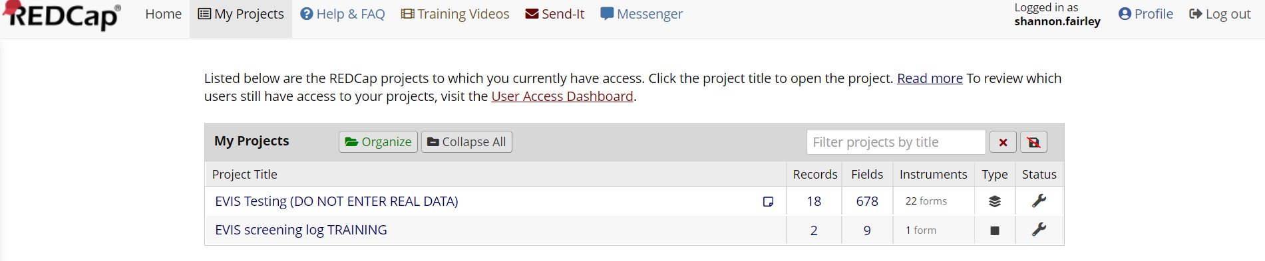
eCRF - REDCap
The website link will take you to the home page where you will find the login screen.
Below this is also the “forgot your password” link which will enable you to reset your password.
Once you have logged in, select “My Projects” and you will be presented with the EVIS training forms and screening log.
Please note: only once you have completed self-training and returned the completed training log will you be granted access to the live database where participant data can be entered.
Notes:
The website link will take you to the home page where you will find the login screen.
Below this is also the “forgot your password” link which will enable you to reset your password from the one allocated by the data centre.
Once you have logged in, navigate to ‘My Projects’ on the top bar tab and you will be presented with the EVIS training database and training screening log.
Once you have completed the self-training, returned to signed training log you will be granted access to the live database where participant data can be entered. Once you have been moved to the live versions of the database, you will be removed from the training databases and the live database and screening log will appear in your ‘projects’ instead.

Slide 4
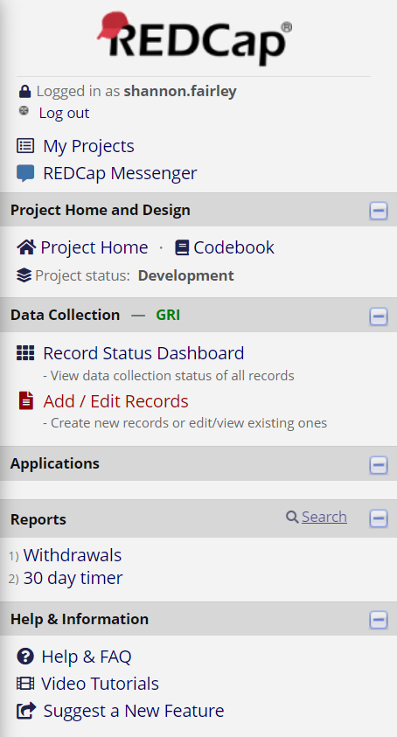
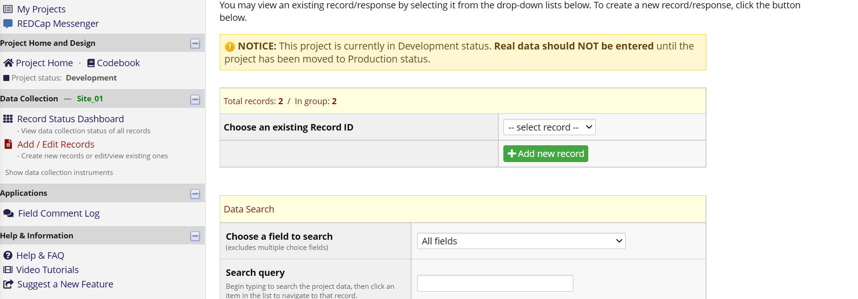

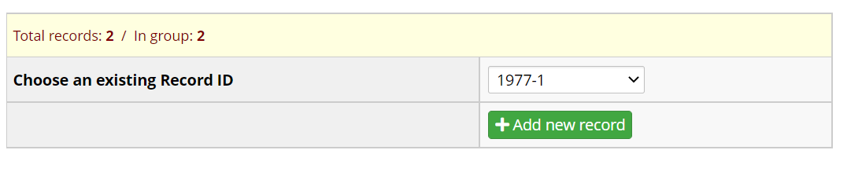
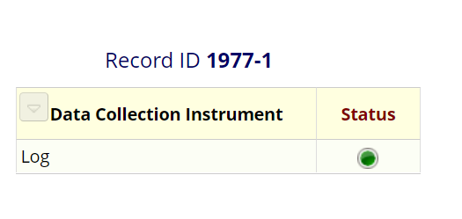
eCRF – REDCap (Screening Log)
To add a participant to the screening log, select “add/edit records”. This also allows you to view existing participant records – as you can see in this slide patient 1977-1 has been selected.
Please ensure that all screening activity is recorded in the live eCRF screening log database for all patients who are actively screened for participation in EVIS, and that this record is kept up to date.
This is irrespective of whether they go on to be randomised or eligible and includes the screening records for eligible participants who then proceed to be randomised.
Notes:
To add a patient to the screening log, simply select “add/edit records” and the select the green “add new record” button.
You can also view existing participant screening logs by selecting an existing record ID from the record log. If you then select the green ‘status’ → ‘log’ button this will allow you to access the participants specific screening log.
Please ensure that all screening activity is recorded in the live eCRF screening log database for all patients who are actively screened for participation in EVIS, and that this record is kept up to date.
This is irrespective of whether they go on to be randomised or eligible and includes the screening records for eligible participants who then proceed to be randomised.

Slide 5
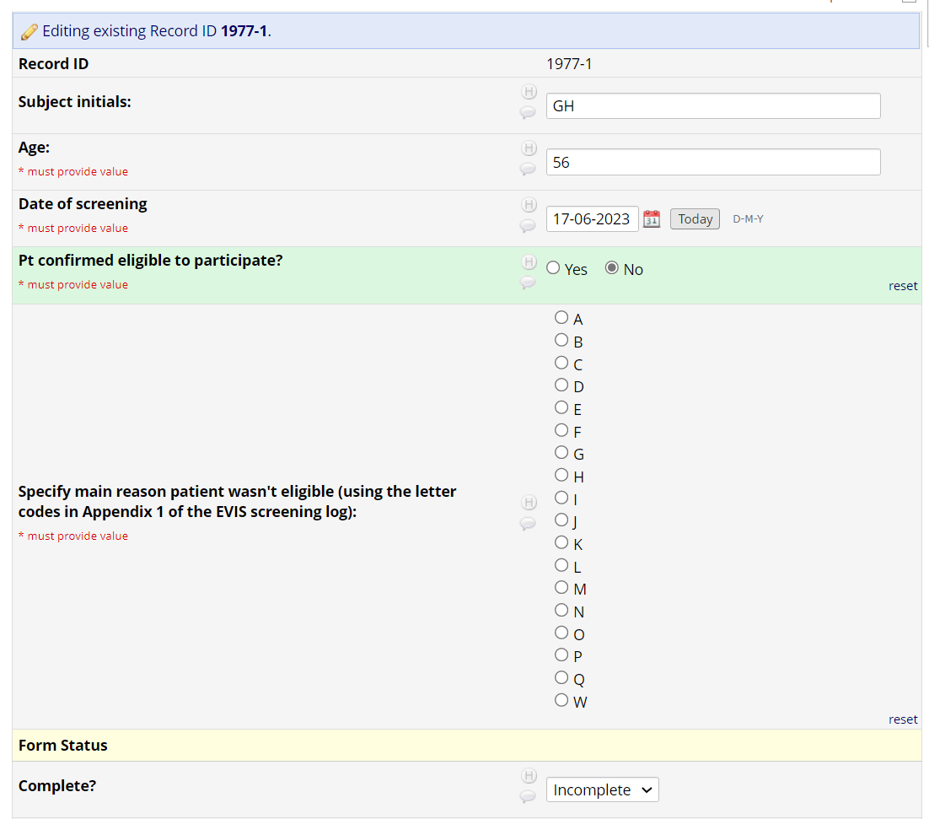
eCRF – REDCap (Screening Log Contd.)
You should now be able to see an example a participant screening log & the data which should be entered on this form to confirm whether or not the patient was eligible or not.
You will need to select the main reason a participant was not eligible, if this was the case. This will be using an exclusion code which can be found in appendix 1 of the paper EVIS Screening log (V4.0).
Notes:
You should now be able to see an example a participant screening log & the data which should be entered on this form to confirm whether or not the patient was eligible or not.
You will need to select the main reason a participant was not eligible, if this was the case. This will be using an exclusion code which can be found in appendix 1 of the paper EVIS Screening log (V4.0).

Slide 6
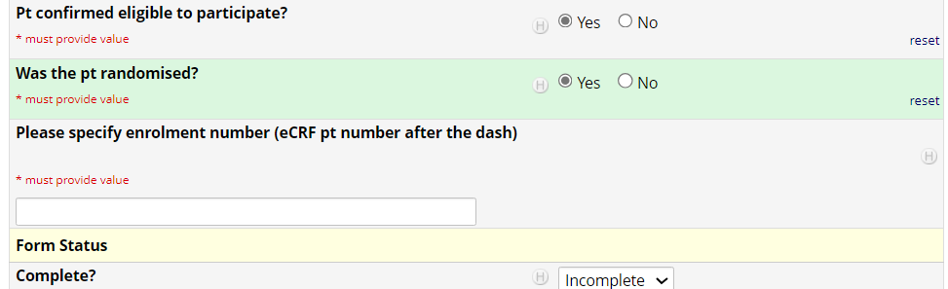
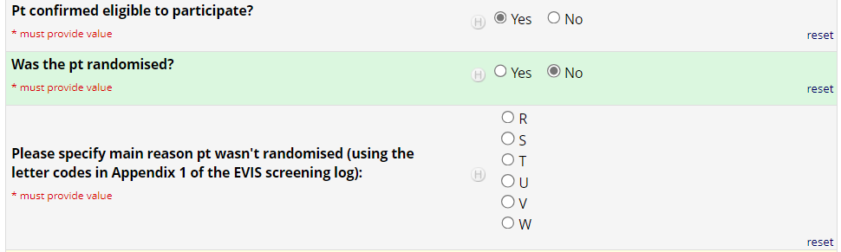
eCRF – REDCap (Screening Log Contd.)
If the patient was eligible, then a pop-up will appear, asking you to confirm if the participant was then randomised.
If they go on to be randomised – you will need to enter their enrolment number (i.e. Record ID Number).
If this is a no then coded options will appear so you can record why they were eligible, but not randomised in to the study.
Once the data has been fully entered, you should select “Complete” on the drop-down menu and save the form.
Notes:
If the patient was eligible, then a pop-up will appear, asking you to confirm if the participant was then randomised.
If they go on to be randomised – you will need to enter their enrolment number (i.e. Record ID Number).
If this is a no then coded options will appear so you can record why they were eligible, but not randomised in to the study.
Once the data has been fully entered, you should select “Complete” on the drop-down menu for form status and save the form.
Just a reminder for the ‘other’ option box – please ensure that no patient identifiable data is included in this free-text box.

Slide 7
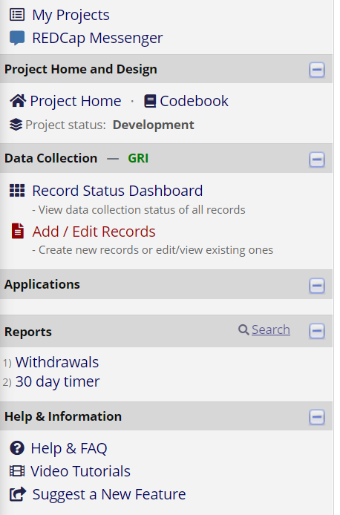
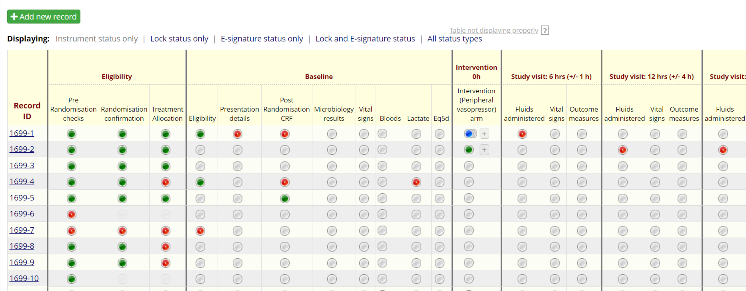

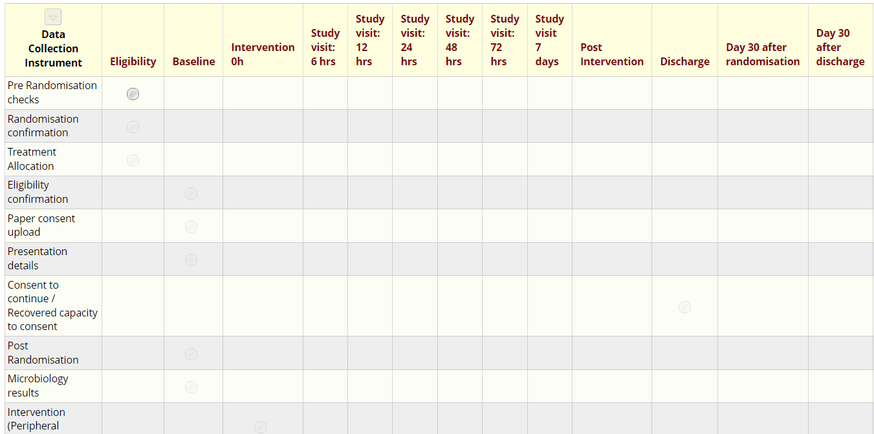
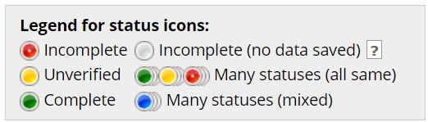
eCRF – REDCap (Patient Overview/New Patient)
From Project Home, when you select “EVIS Training” and “Record Status Dashboard” you will be presented with all of the data records for each patient entered so far and the ability to add a new patient.
To add a new patient, select the “Add/Edit Records” button, followed by the green ‘Add new record’ button.
Or, select a specific participant’s record ID, from the ‘select record’ drop-down, to go in to the database and view data for that specific patient.
The above legend indicates the status of each form.
Notes:
From Project Home, when you select “EVIS Training” and “Record Status Dashboard” you will be presented with all of the data records for each patient entered so far and the have the ability to add a new patient.
To add a new patient, select the “Add/Edit Records” button, followed by the green ‘Add new record’ button.
Or, select a specific participant’s record ID, from the ‘select record’ drop-down, to go in to the database and view data for that specific patient.
The buttons are colour coded, so green means that section of the eCRF has been completed, yellow means it is unverified, and red is incomplete.

Slide 8
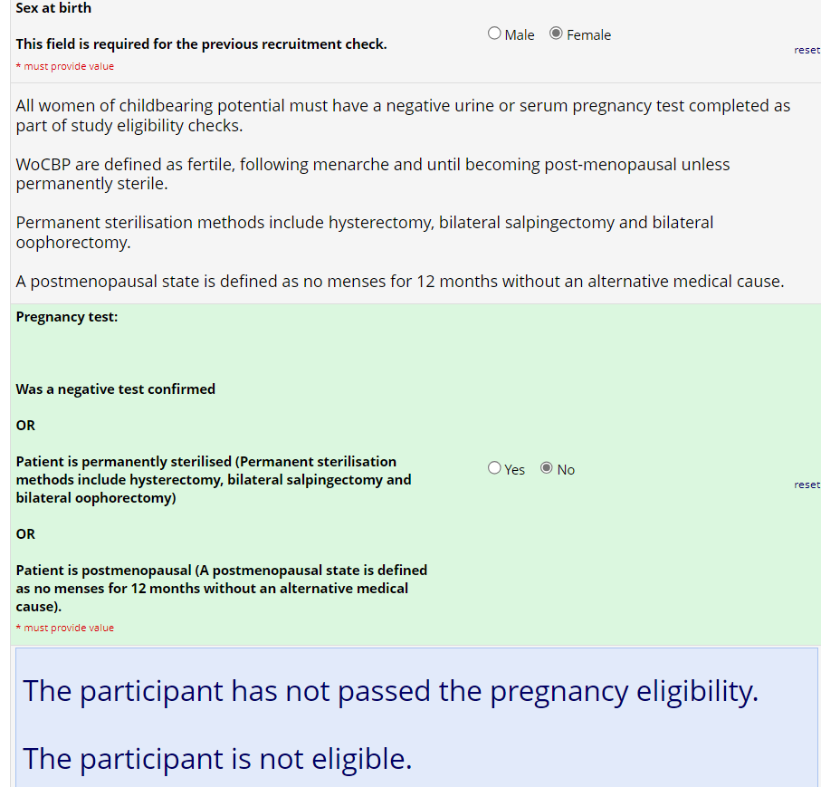
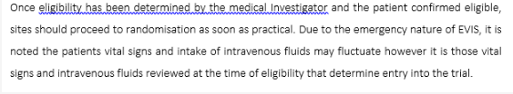
eCRF – REDCap (Pre-Randomisation Checks)
The Pre-Randomisation Checks must be completed to match the inclusion/exclusion criteria.
If ‘sex at birth’ is selected as ‘female’ then you must confirm that either a negative pregnancy test has been confirmed or was not needed. If you do not then the eCRF will block off all future pages, as well as your ability for you to go on to randomise the patient.
Notes:
The Pre-Randomisation Checks must be completed to match the inclusion/exclusion criteria.
If ‘sex at birth’ is selected as ‘female’ then you must confirm that either a negative pregnancy test has been confirmed or was not needed. If you do not then the eCRF will block off all future pages, as well as your ability for you to go on to randomise the patient.
We do specify in the protocol that once eligibility has been determined by the medical investigator and the patient has been confirmed as eligible, then sites should proceed to randomisation as soon as practical. Due to the emergency nature of EVIS it is noted that patients vital signs and intake of IV fluids may fluctuate, however it is those vital signs and IV fluids received at the time of eligibility that determine entry in to the Trial. I.e. If a patient is assessed and determined to be eligible, but in the time it takes to consent them and sit down at a computer to randomise them on REDCAP they have received additional fluids taking them over 1500ml, they are still eligible as they had received < 1500mls when assessed for eligibility.

Slide 9
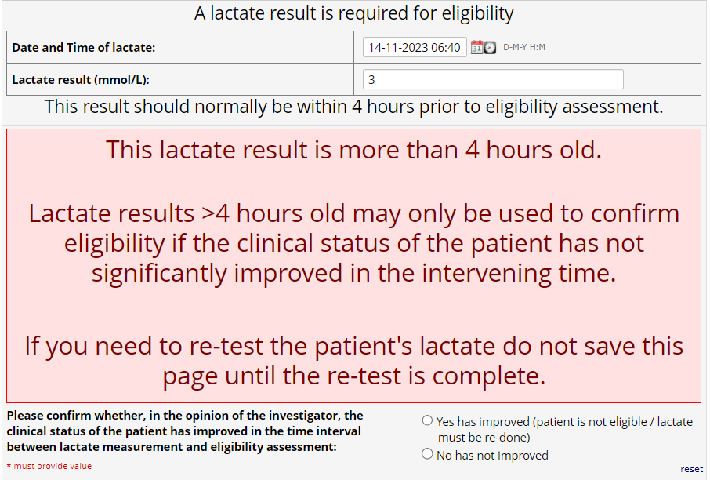
eCRF – REDCap (Pre-Randomisation Checks Cont.)
A serum lactate must be measured for eligibility.
The serum lactate should normally be measured within 4 hours prior to eligibility assessment.
However, longer timeframes (> 4 hours) may be used to confirm eligibility if, in the opinion of the investigator, the clinical status of the patient has not significantly improved in the intervening time between lactate measurement and eligibility assessment.
Notes:
A serum lactate must be measured for eligibility.
The serum lactate should normally be measured within 4 hours prior to eligibility assessment.
However, longer timeframes (> 4 hours) may be used to confirm eligibility if, in the opinion of the investigator, the clinical status of the patient has not significantly improved in the intervening time between lactate measurement and eligibility assessment.

Slide 10

eCRF – REDCap (Pre-Randomisation Checks Cont.)
The eCRF will allow you to proceed with randomisation if the lactate result is LESS than 4 hours old.
If GREATER than 4 hours old, you must confirm whether the clinical status of the patient has improved or not. If they have NOT improved, then you can proceed to randomisation with the lactate measurement already collected.
If the patient has improved, then the eCRF will block off all future pages as well as your ability to randomise the patient. This will be the case until the lactate has been re-measured.
If you need to re-test the patient's lactate do not save the Pre-Randomisation Checks page until the re-test is complete and the new lactate measurement is recorded. Based on this measurement, the patient will then either be eligible or not.
Notes:
The eCRF will allow you to proceed with randomisation if the lactate result is LESS than 4 hours old.
If GREATER than 4 hours old, you must confirm whether the clinical status of the patient has improved or not. If they have NOT improved, then you can proceed to randomisation with the lactate measurement already collected.
If the patient has improved, then the eCRF will block off all future pages as well as your ability to randomise the patient. This will be the case until the lactate has been re-measured.
If you need to re-test the patient's lactate do not save the Pre-Randomisation Checks page until the re-test is complete and the new lactate measurement is recorded. Based on this measurement, the patient will then either be eligible or not.

Slide 11
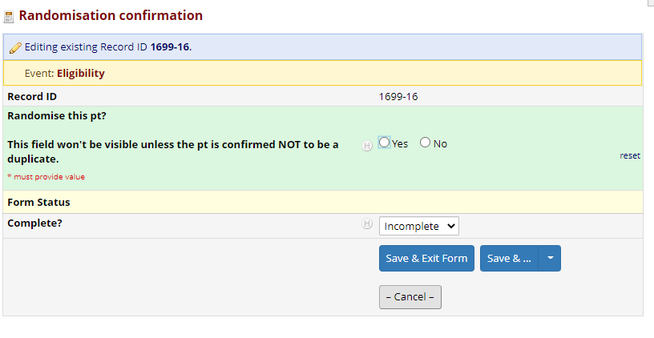
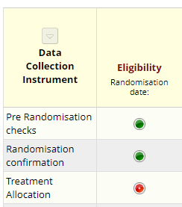
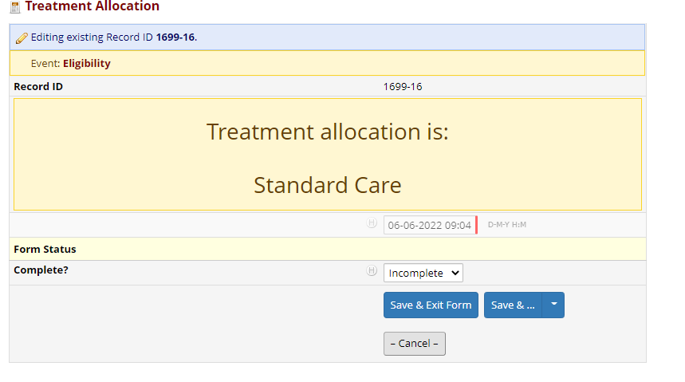
eCRF – REDCap (Randomisation)
Once the “Pre-Randomisation Checks” and “Randomisation Confirmation” pages have been completed, then REDCAP will proceed to randomising the patient.
The “Treatment Allocation” page will produce a result of which arm the patient has been randomised to as can be seen.
Notes:
Once the “Pre-Randomisation Checks” and “Randomisation Confirmation” pages have been completed, then REDCAP will proceed to randomising the patient.
The “Treatment Allocation” page will produce a result of which arm the patient has been randomised to.

Slide 12
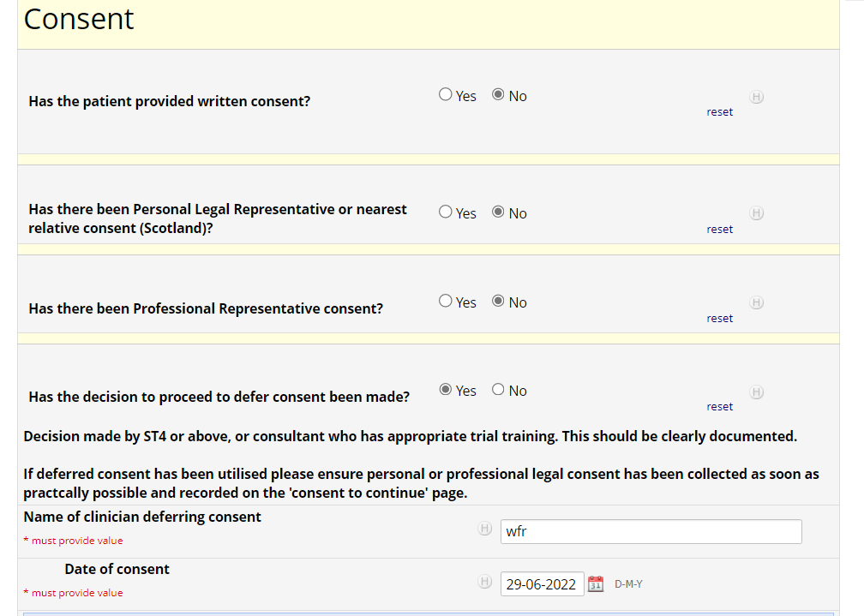
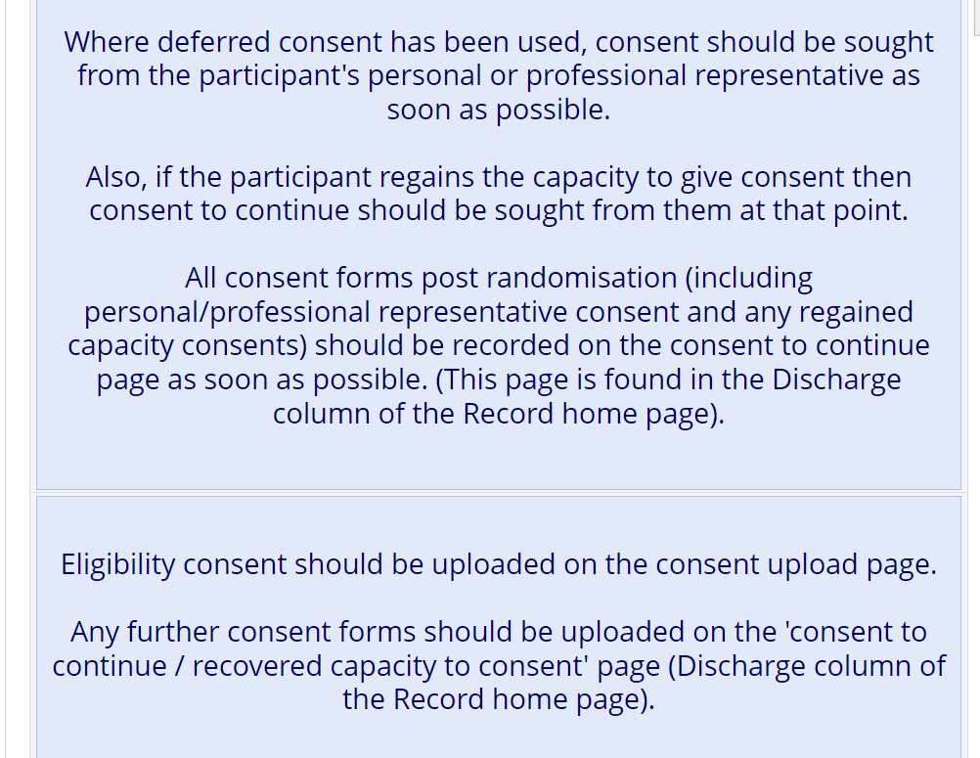
eCRF – REDCap (Consent)
Within the “Eligibility Confirmation” page there is a consent check, to confirm that informed consent has taken place, as well as which type of consent was obtained.
Informed Consent should always be sought from the participant as soon as they regain capacity. For example if a Personal Legal Representative consents on behalf of the patient, once the patient has regained capacity Informed Consent should be sought directly from the patient themselves.
Where deferred consent is used (which is only available for sites in England and Wales & not currently an option in Scotland), consent should be sought from the participants personal or professional representative as soon as possible.
A copy of the consent form should be uploaded directly onto REDCap via the consent upload page.
Notes:
Within “Eligibility Confirmation” page – there is a consent check, to confirm that informed consent has taken place, as well as which type of consent was obtained.
Informed consent should always be sought from the participant as soon as they regain capacity. For example, if a Personal Legal Representative consents on behalf of the patient, once the patient has regained capacity then informed consent should be sought directly from the patient themselves.
Where deferred consent is used (which is only available for sites in England and Wales & not currently an option in Scotland), consent should be sought from the participants personal or professional representative as soon as possible.
The sponsor monitor has also requested that a copy of the consent form to be uploaded directly on to REDCAP via the ‘paper consent upload’ page. The sponsor monitor will have the capacity to view this page, to then check the ICF’s as they are uploaded to ensure that these have been completed appropriately. So, if you could make sure to upload these in a timely manner to enable this. The copy of the consent taken at eligibility should be uploaded on the ‘paper consent upload’ page.
ANY further consent forms post randomisation (i.e. when another form of consent rather than patient consent is obtained) should be uploaded on the ‘consent to continue/recovered capacity to consent’ page as soon as possible. This can be found in the Discharge column of the record home page.

Slide 13
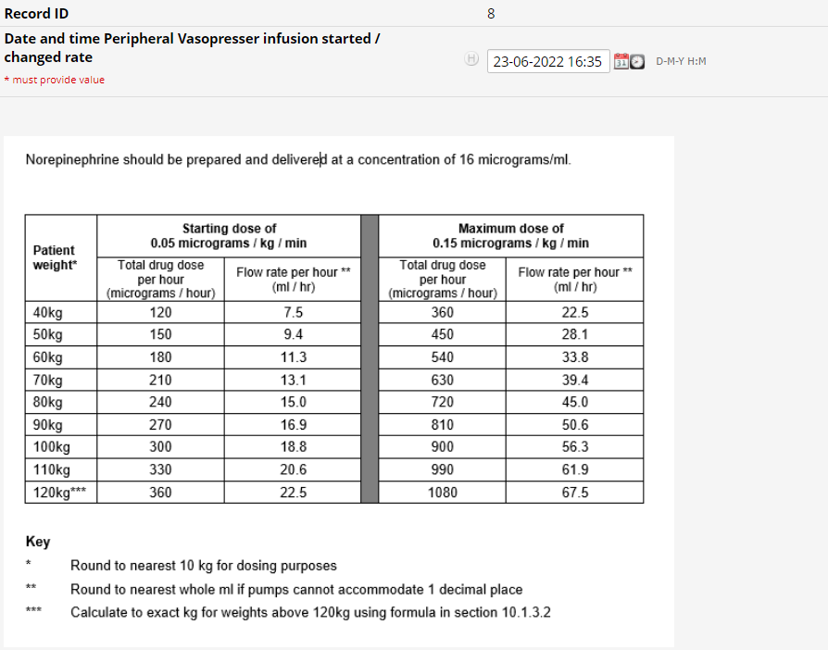
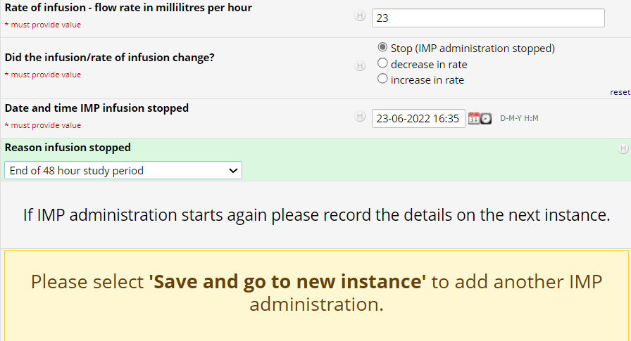
eCRF – REDCap (Infusion eCRF – Intervention Arm)
For participants randomised to the intervention arm, the “Intervention (Peripheral vasopressor) arm” page provides space to enter details on the peripheral infusion.
This page is automatically blocked off for patients randomised to the standard care arm.
The page includes space to record;
Date & time the infusion was started and/or changed rate.
Rate of infusion
If the infusion or infusion rate changed i.e. stopped, increased in rate or decreased in rate.
If the infusion is stopped, decreased or increased in rate, then please complete this page. A new page should be completed for each occurrence using the “Save and go to new instance” option.
If the infusion is stopped then the page requests the date and time it was stopped as well as the reason. If IMP administration begins again after a ‘stop’ is recorded then again record the details of this using ‘Save and go to new instance’. The page can be used and saved an unlimited number of times.
Notes:
For participants randomised to the intervention arm, the “Intervention (Peripheral vasopressor) arm” page provides space to enter details on the peripheral infusion.
This page is automatically blocked off for patients randomised to the standard care arm.
The page includes space to record;
Date & time the infusion was started and/or changed rate.
Rate of infusion
If the infusion or infusion rate changed i.e. stopped, increased in rate or decreased in rate.
We have also included the dose table from the protocol on this page to provide assistance.
If the infusion is stopped, decreased or increased in rate, then please complete this page. A new page should be completed for each occurrence using the “Save and go to new instance” option.
If the infusion is stopped then the page requests the date and time it was stopped as well as the reason. If IMP administration begins again after a ‘stop’ is recorded then again record the details of this using ‘Save and go to new instance’. The page can be used and saved an unlimited number of times.

Slide 14
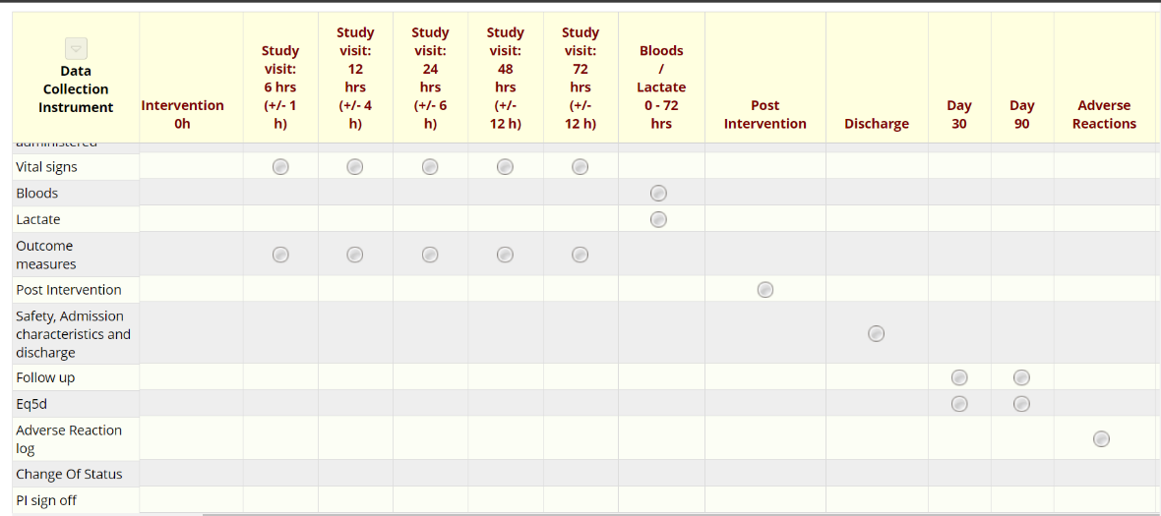

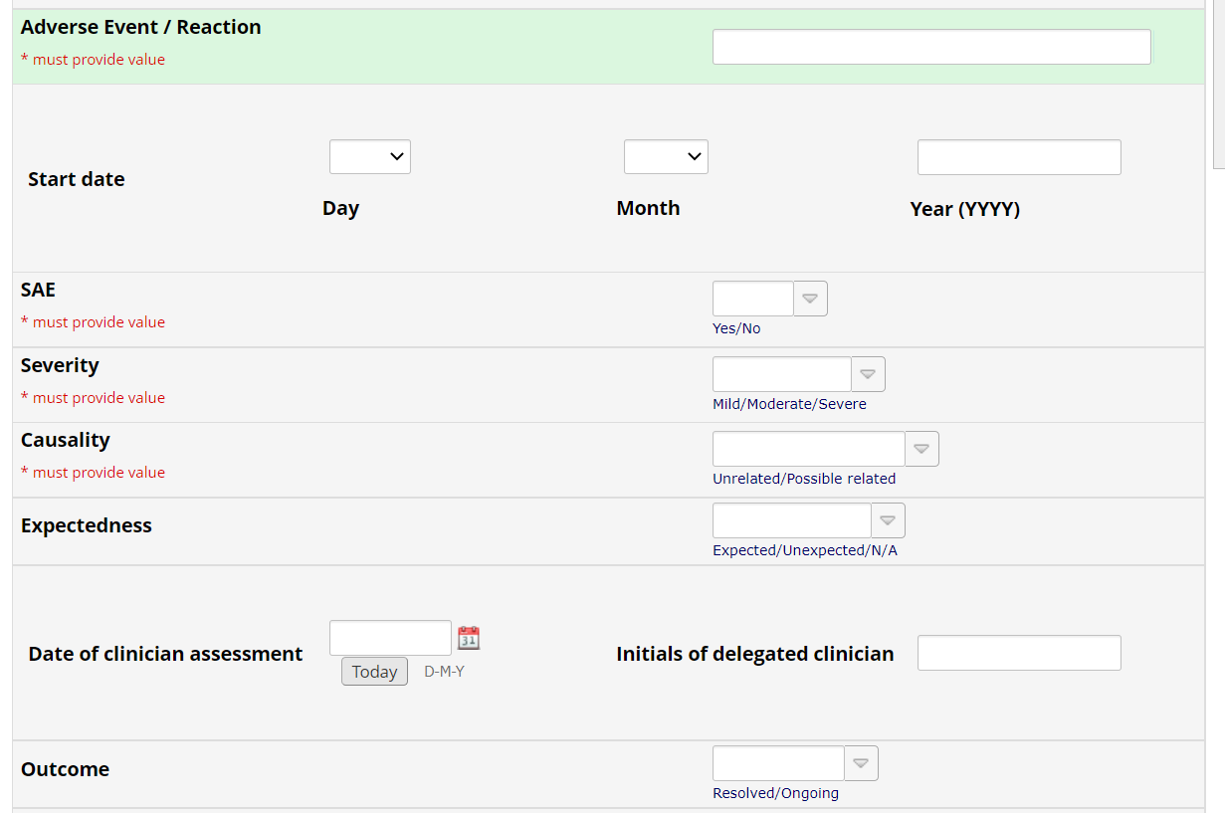
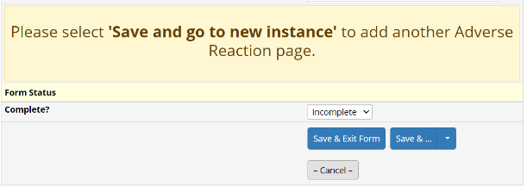
eCRF – REDCap (Adverse Event)
We will be using the eCRF to record any adverse events/reactions for a patient, in the “Adverse Reactions” page.
Select “Adverse Reactions” on the patients data screen and proceed to enter the details of the AE/AR. Ensure the page is saved as complete once done.
If an event is considered related to the trial IMP (that is, an adverse reaction) and was not present at baseline assessment or has worsened since baseline then it should be recorded within the eCRF.
There are some mandatory fields when completing this form, such as the severity/causality assessments. You will not be able to save this page until these are completed.
Another AE can be added by selecting “Save and go to new instance”
Please refer to the protocol for more detailed information on what events should be recorded as an AE/AR.
Notes:
We will be using the eCRF to record any adverse events/reactions for a patient, in the “Adverse Reactions” page.
Select “Adverse Reactions” on the patients data screen and proceed to enter the details of the AE/AR. Ensure the page is saved as complete once done.
If an event is considered related to the trial IMP (that is, an adverse reaction) and was not present at baseline assessment or has worsened since baseline then it should be recorded within the eCRF.
There are some mandatory fields when completing this form, such as the severity/causality assessments. You will not be able to save this page until these are completed.
Another AE can be added by selecting “Save and go to new instance‘.
Please refer to the protocol for more detailed information on what events should be recorded as an AE/AR.

Slide 15
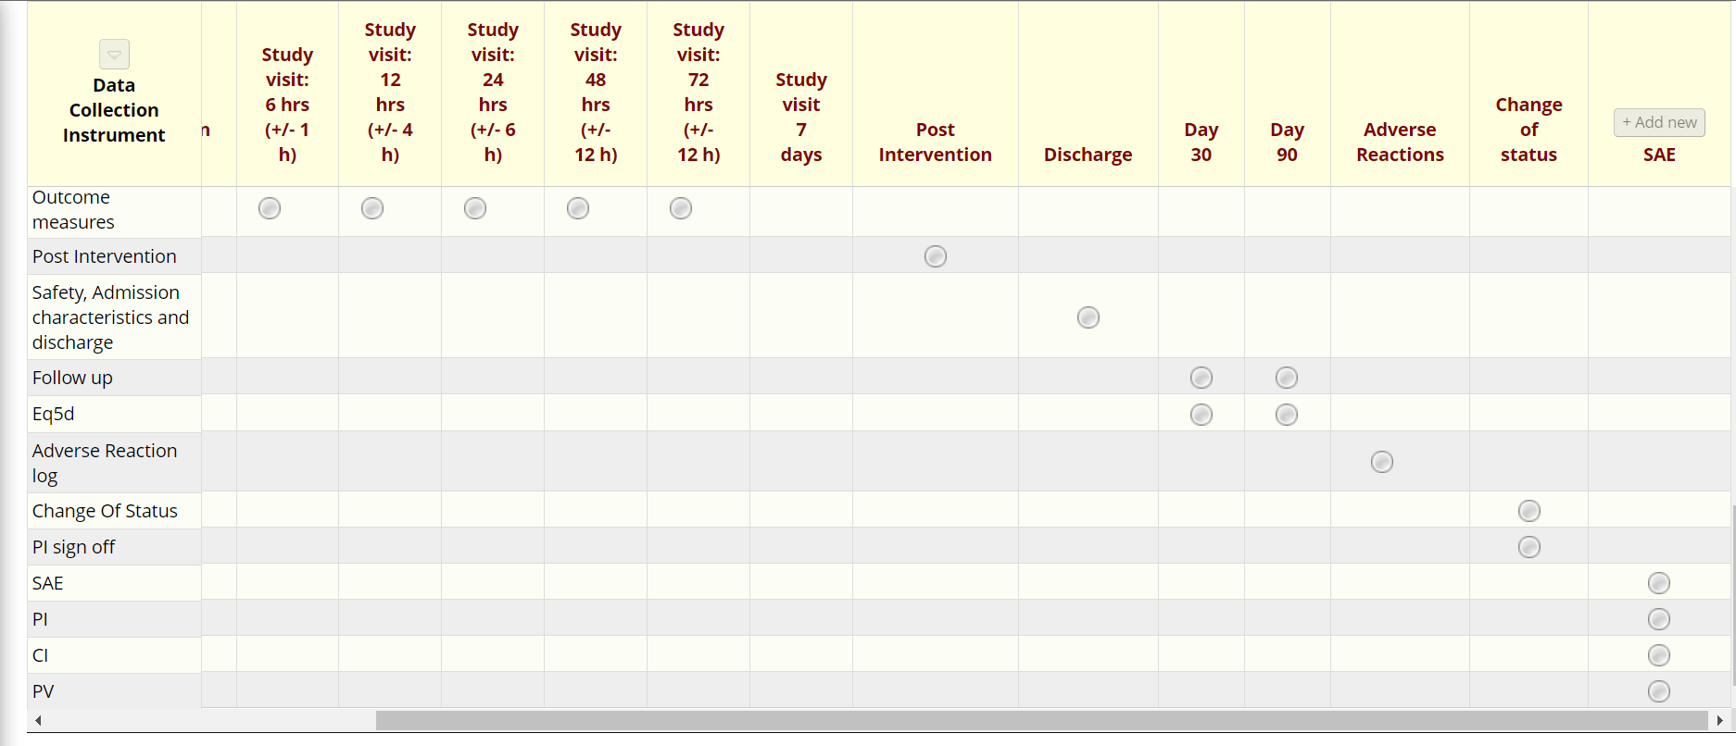
eCRF – REDCap (SAEs)
We will also be using the eCRF to record any SAE’s for a patient, in the “SAE” page.
The SAE form can be accessed as above via Record Status Dashboard and by selecting the relevant participant number. Please enter all details that are known at the time and submit via eCRF within 24 hours of awareness.
There are also some mandatory fields when completing this form, such as the PI’s email address so they can access and complete their section of the SAE form. You will not be able to save this page until these are completed.
If SAE reporting is not possible via the eCRF, a paper SAE form has been included in the ISF. This can then be completed and forwarded to the PV office by fax (07989 470505) or by email to pharmacovig@glasgowctu.org. If you require further paper SAE forms please contact the Project Manager (Hannah.Greenwood@ggc.scot.nhs.uk)
Notes:
We will also be using the eCRF to record any SAE’s for a patient, in the “SAE” page.
The SAE form can be accessed as above via Record Status Dashboard and by selecting the relevant participant number. Please enter all details that are known at the time and submit via eCRF within 24 hours of awareness.
There are also some mandatory fields when completing this form, such as the PI’s email address so they can access and complete their section of the SAE form. You will not be able to save this page until these are completed.
If SAE reporting is not possible via the eCRF, a paper SAE form has been included in the ISF. This can then be completed and forwarded to the PV office by fax (07989 470505) or by email to pharmacovig@glasgowctu.org. If you require further paper SAE forms please contact the Project Manager (Hannah.Greenwood@nhs.scot)

Slide 16
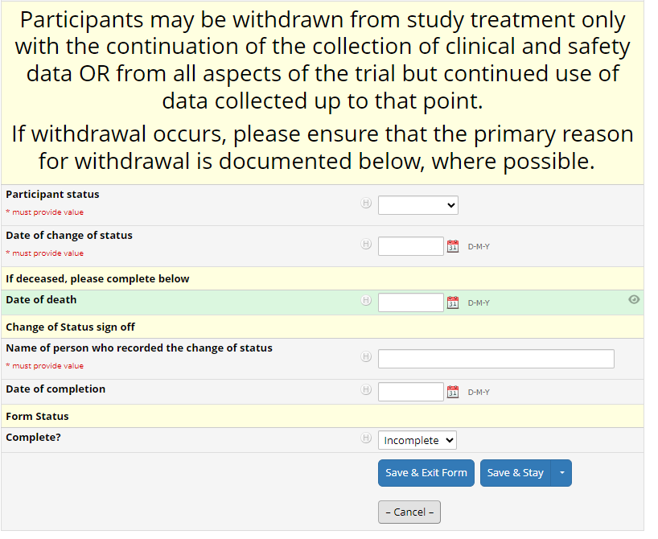
eCRF – Change of Status
The status of participants should be updated if/when applicable.
The options provided are active, withdrawn, deceased or transferred.
Participants may be withdrawn from study treatment only with continuation of the collection of clinical and safety data, or from all aspects of the trial but continued use of data collected up to that point. If withdrawal occurs, please ensure that the primary reason for withdrawal is documented where possible.
If an EVIS participant has been transferred to another hospital during the 48 hour treatment period, the trial team must ensure there is appropriate documentation within the medical notes to state that the patient is "off EVIS treatment" and standard of care should continue. The eCRF should be updated to state the patient has been Transferred. With the participant withdrawn from study treatment alone, they should be followed up as the patient's wishes.
Notes:
The change of status page should be updated to reflect a change in the status of participants (as/when applicable).
Options provided are active, withdrawn, deceased or transferred.
Participants may be withdrawn from study treatment only with continuation of the collection of clinical and safety data, or from all aspects of the trial but continued use of data collected up to that point. If withdrawal occurs, please ensure that the primary reason for withdrawal is documented where possible.
If an EVIS participant has been transferred to another hospital during the 48 hour treatment period, the trial team must ensure there is appropriate documentation within the medical notes to state that the patient is "off EVIS treatment" and standard of care should continue. The eCRF should be updated to state the patient has been Transferred. With the participant withdrawn from study treatment alone, they should be followed up as the patient's wishes.
The change of status to withdrawn or deceased, should trigger the eCRF to block out the pages which no longer need to be recorded due to the change in status.

Slide 17
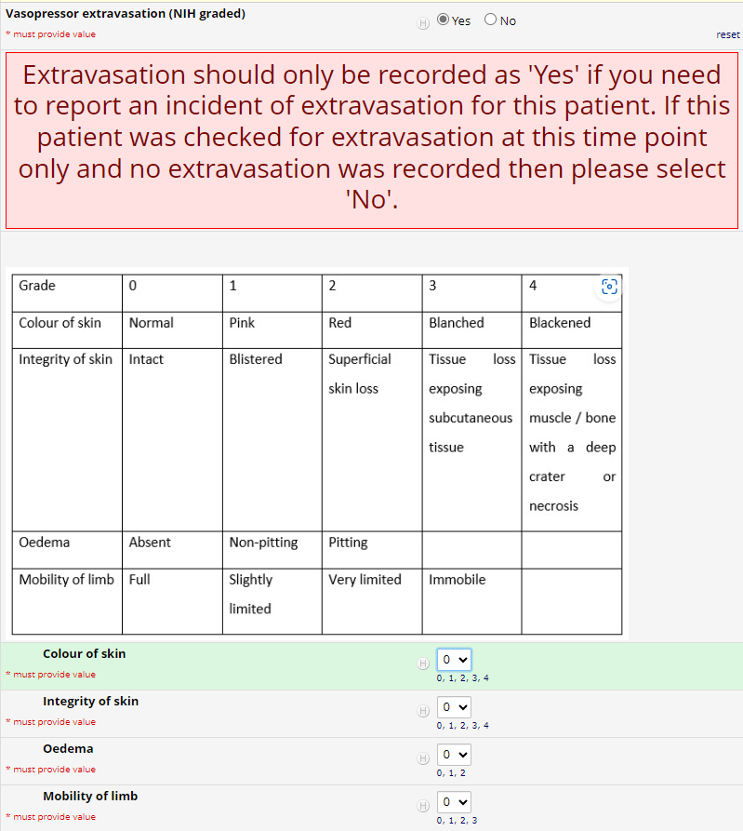
eCRF Extravasation
Safety data on extravasation will be collected in the eCRF on the Outcome Measures Pages at each time point.
Extravasation should only be recorded as ‘Yes’ if you need to report an incident of extravasation present for the patient.
If the patient was checked for extravasation at the time point ONLY, and no extravasation was present, then please ensure that ‘no’ is selected.
The Extravasation grading table from the protocol is provided for reference, to help with reporting the grade of extravasation present.
Notes:
Safety data on extravasation will be collected in the eCRF on the Outcome Measures Pages at each time point.
Extravasation should only be recorded as ‘Yes’ if you need to report an incident of extravasation present for the patient.
If the patient was checked for extravasation at the time point ONLY, and no extravasation was present, then please ensure that ‘no’ is selected.
The Extravasation grading table from the protocol is provided for reference, to help with reporting the grade of extravasation present.

Slide 18
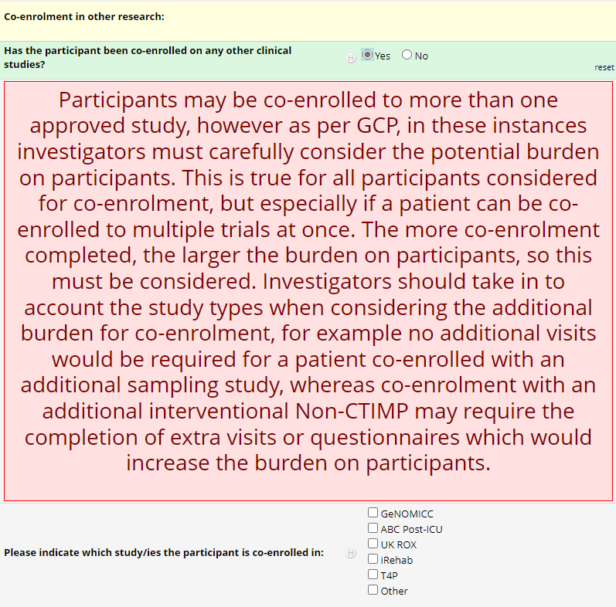
eCRF Co-enrolment
Co-enrolment of EVIS patients must be recorded in the live eCRF – using the co-enrolment field in the ‘Other Interventions’ column.
As a Type B CTIMP Co-enrolment between EVIS and other CTIMP Trials is prohibited, as a condition of our MHRA approval. This is included in the current exclusion criteria.
Co-enrolment in observational studies is permitted. For example, with studies that involve only the collection of data (e.g. questionnaires) or tissue samples (e.g. blood).
Participants who are active in the interventional phase of a non-CTIMP may be co-enrolled to EVIS, but this must be agreed by both Sponsors in advance of co-enrolment. The list of currently approved trials appears in the eCRF to select from.
If a patient is co-enrolled with another non-approved Trial then please ensure this is reported to the EVIS Trial team as soon as possible, once identified.
Fields to complete are the date the patient was randomised in the other trial & the treatment the participant was allocated to.
Co-enrolment must also be documented in all co-enrolled participant medical notes.
Notes:
Co-enrolment of EVIS patients must be recorded in the live eCRF – using the co-enrolment field in the ‘Other Interventions’ column.
As a Type B CTIMP Co-enrolment between EVIS and other CTIMP Trials is prohibited, as a condition of our MHRA approval. This is included in the current exclusion criteria.
Co-enrolment in observational studies is permitted. For example, with studies that involve only the collection of data (e.g. questionnaires) or tissue samples (e.g. blood).
Participants who are active in the interventional phase of a non-CTIMP may be co-enrolled to EVIS, but this must be agreed by both Sponsors in advance of co-enrolment. The list of currently approved trials appears in the eCRF to select from.
If a patient is co-enrolled with another non-approved Trial then please ensure this is reported to the EVIS Trial team as soon as possible, once identified.
Fields to complete are the date the patient was randomised in the other trial & the treatment the participant was allocated to.
Co-enrolment must also be documented in all co-enrolled participant medical notes.
Participants may be co-enrolled to more than one approved study, however as per GCP, in these instances investigators must carefully consider the potential burden on participants. This is true for all participants considered for co-enrolment, but especially if a patient can be co-enrolled to multiple trials at once. The more co-enrolment completed, the larger the burden on participants, so this must be considered. Investigators should take in to account the study types when considering the additional burden for co-enrolment, for example no additional visits would be required for a patient co-enrolled with an additional sampling study, whereas co-enrolment with an additional interventional Non-CTIMP may require the completion of extra visits or questionnaires which would increase the burden on participants.

Slide 19
EVIS instructions for data entry after death
Complete all data before time of death.
Complete change of status page.
Complete final CENTRAL vasopressor volumes on 'Outcome measures' page at time point directly after death (record the time vasopressors stopped as the time of the time point) - only applies if death didn't fall within a time point window).
Complete final fluid volumes (on 'Fluids administered' page) at time point directly after death (record the time fluids stopped as the time of the time point) - only applies if death didn't fall within a time point window).
Complete 'Other interventions page‘.
Complete 'Outcomes (Secondary)' page.
Complete 'Safety and discharge page’ - including Pulmonary Oedema, Death at index hospitalisation, Length of stay fields, Diagnosis.
If the patient died prior to 30 days after randomisation - Complete Day 30 'Mortality check/organ support days page‘ & Complete EQ-5D 30 days after randomisation as not completed as participant is deceased.
If the patient died after 30 days - Complete Day 30 & 90 'Mortality check/organ support days page‘ & Complete EQ-5D 30 & 90 days after randomisation – Mark day 90 EQ-5D as not completed as participant is deceased.
**Complete admissions Follow up 90 days.
Do not save pages after death if they are not used. This sets off queries.
Notes:
A message should pop up on the outcome measures page (at all specified time points) to act as a reminder that if a participant is deceased, then please complete the final CENTRAL vasopressor volumes on the ‘outcome measures’ page directly after time of death. Use the time of removal of vasopressors as the time of the time point.

Slide 20
Fluids and vasopressors completion
Please ensure that a IMP Infusion Stop time is recorded for all participants randomised to the intervention arm.
Please enter the cumulative TOTALs for 1). the volume of fluid 2). Total cumulative dose of CENTRAL vasopressors, that the patient has received since randomisation (0 hours) at each time point, including the volume/dose administered in most recent time period.
For Example: If Vasopressin was administered at 6 hours, but not administered again for the rest of the 48 hour study period, Vasopressin must still be selected at every time point, with the total administered at 6 hours entered on each page.
The eCRF should flag up error messages if you do enter a total volume/dose at a later time point which is lower than that entered at an earlier time, to try and keep you right on this.
The vasopressors on the outcomes measures pages, should be recorded as whole numbers. With rounding up or down to nearest whole number if the calculated total dose includes a decimal point.
Any IV medicines with a prepared volume greater than 100ml must be recorded in the eCRF as maintenance fluids (see also Appendix C).
For fields which have changing values & when participants survive though to discharge - all other fields should be completed (Other interventions, Outcomes (Secondary), Safety and Discharge pages).
Notes:
Please ensure that a IMP Infusion Stop time is recorded for all participants randomised to the intervention arm.
Please enter the cumulative TOTALs for 1). the volume of fluid 2). Total cumulative dose of CENTRAL vasopressors, that the patient has received since randomisation (0 hours) at each time point, including the volume/dose administered in most recent time period.
For Example: If Vasopressin was administered at 6 hours, but not administered again for the rest of the 48 hour study period, Vasopressin must still be selected at every time point, with the total administered at 6 hours entered on each page.
The eCRF should flag up error messages if you do enter a total volume/dose at a later time point which is lower than that entered at an earlier time, to try and keep you right on this.
The vasopressors on the outcomes measures pages, should be recorded as whole numbers. With rounding up or down to nearest whole number if the calculated total dose includes a decimal point.
Any IV medicines with a prepared volume greater than 100ml must be recorded in the eCRF as maintenance fluids (see also Appendix C).
For fields which have changing values & when participants survive though to discharge - all other fields should be completed (Other interventions, Outcomes (Secondary), Safety and Discharge pages).

Slide 21
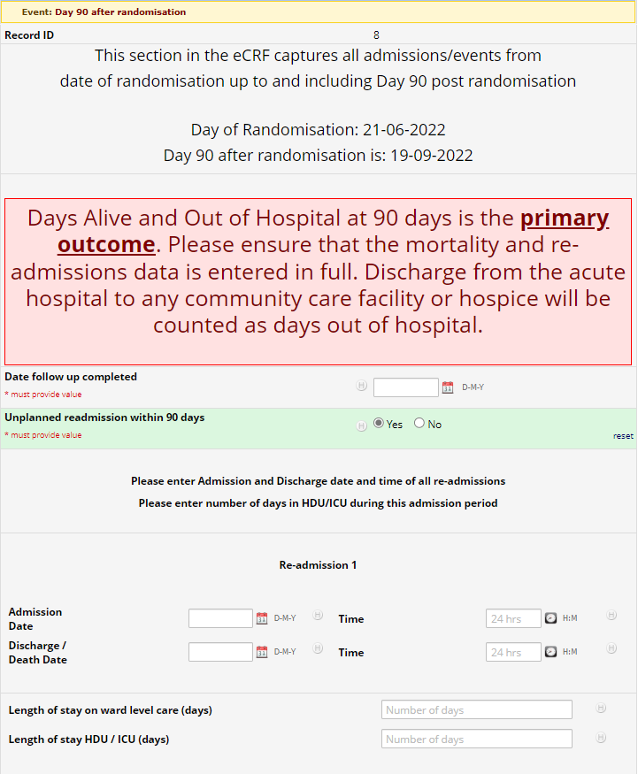
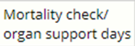
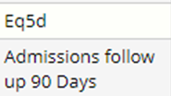
eCRF – Primary End Point
Primary Outcome
Days Alive and Out of Hospital at 90 days is a primary outcome.
The mortality check must be performed after day 90, and within the time window (+ 14 Days), by reviewing the participants’ medical records. The assessment must reflect the participant’s status on day 90.
Protocol deviations will be recorded where the review is completed out with this window, including day 90, unless the patient is already deceased.
Discharge from the acute hospital to any community care facility or hospice will be counted as days out of hospital.
Please ensure that the;
1. Discharge Page
2. Mortality checks at Day 30 & Day 90 post randomisation
3. And details of any Unplanned re-admissions within 90 days of randomisation (Admissions Follow up 90 Days) are all in entered in full in the eCRF.
** All of which are required to ‘piece’ together the primary outcome behind the scenes.
Notes:
- Primary Outcome = Days Alive and Out of Hospital at 90 days is a primary outcome.
- The mortality check must be performed after day 90, and within the time window (+ 14 Days), by reviewing the participants’ medical records. The assessment must reflect the participant’s status on day 90.
- Protocol deviations will be recorded where the review is completed out with this window, including day 90, unless the patient is already deceased.
- Discharge from the acute hospital to any community care facility or hospice will be counted as days out of hospital.
- Please ensure that the;
1. Discharge Page
2. Mortality checks at Day 30 & Day 90 post randomisation
3. And details of any Unplanned re-admissions within 90 days of randomisation (Admissions Follow up 90 Days) are all in entered in full in the eCRF. All of which are required to ‘piece’ together the primary outcome behind the scenes.
- Outcome measures - SOFA score is an exploratory outcome only, so data collection is not mandatory. This is the same for the Daily routine blood results.
For any eCRF queries contact the Project Manager, Hannah Greenwood – Hannah.Greenwood@nhs.scot

