Slide 1




EVIS: IMP Prescribing
EVIS Training Module 2
Version: 3.0 23.01.2025
Study: EVIS – Early Vasopressors in Sepsis EudraCT: 2021-006886-39
Chief Investigator: Dr Alasdair Corfield Sponsor: NHS Greater Glasgow & Clyde
Warning: This training module is version controlled. Printed or downloaded copies may not be the current version. See www.evis.scot.nhs.uk

Slide 2
Intervention Arm IMP:
Peripheral Norepinephrine

Slide 3
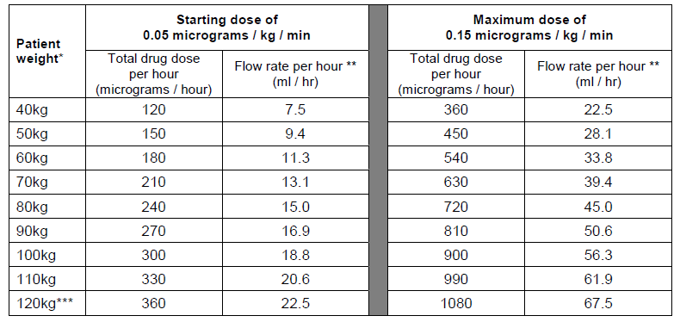
Peripheral norepinephrine: Dose table
(Intervention arm)
  Norepinephrine dose: Target to MAP ≥ 65 mmHg
Table applies only for norepinephrine infusion containing 16 micrograms/ml
Key:
* Round to nearest 10 kg for dosing
* * Round to nearest whole ml if pumps cannot accommodate 1 decimal place
* * * Calculate to exact kg for weights above 120kg
Notes:
23/01/2025
History V1.0 2010
3

Slide 4
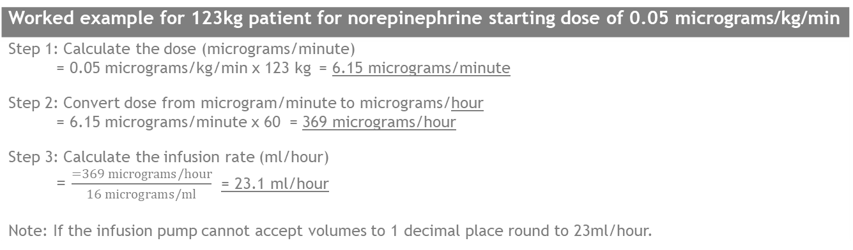
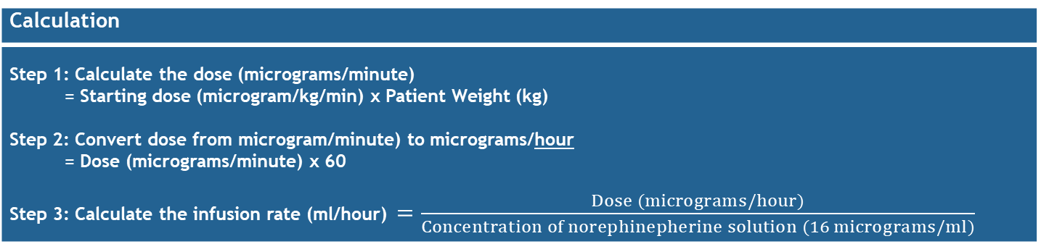
Peripheral norepinephrine: Dose calculation
(Intervention arm)
Calculate exact dose for patients > 120kg
Calculation
Step 1: Calculate the dose (micrograms/minute) = Starting dose (microgram/kg/min) x Patient Weight (kg) Step 2: Convert dose from microgram/minute) to micrograms/hour = Dose (micrograms/minute) x 60 Step 3: Calculate the infusion rate (ml/hour) $=\frac{Dose (micrograms/hour)}{Concentration of norephinepherine solution (16 micrograms/ml)}$
Worked example for 123kg patient for norepinephrine starting dose of 0.05 micrograms/kg/min
Step 1: Calculate the dose (micrograms/minute) = 0.05 micrograms/kg/min x 123 kg = 6.15 micrograms/minute Step 2: Convert dose from microgram/minute to micrograms/hour = 6.15 micrograms/minute x 60 = 369 micrograms/hour Step 3: Calculate the infusion rate (ml/hour) = $\frac{=369 micrograms/hour}{16 micrograms/ml}$ = 23.1 ml/hour Note: If the infusion pump cannot accept volumes to 1 decimal place round to 23ml/hour.
Notes:
23/01/2025
History V1.0 2010
4

Slide 5
Peripheral norepinephrine: Dosing info
(Intervention arm)
Study treatment duration: Up to 48 hours from time of randomisation
Route of administration: peripheral venous cannula
Preparation: solution containing norepinephrine 16 micrograms/ml
Diluent: 0.9% sodium chloride or 5% glucose
Other peripheral vasopressors: Patients in this arm should not receive any other peripheral vasopressor infusion during the 48 hour treatment duration
Dose up and down up-titrations
  Guidance in protocol but check with research team as local policy can be used
  If target MAP ≥ 65mmHg achieved immediately post-randomisation initial infusion rate must be zero. Rate can be increased at any point during 48 hour study period.
Notes:
23/01/2025
History V1.0 2010
5

Slide 6
Peripheral norepinephrine: Titration guidance
(Intervention arm)
Dose up-titration guidance
  If MAP < 65 mmHg within 15 mins of infusion starting, ↑ infusion rate to maximum of 0.10 micrograms/kg/min
  Reassess after 15 minutes. If MAP < 65mmHg then ↑ infusion rate incrementally to max 0.15 micrograms/kg/min
  If MAP < 65 mmHg after 15 minutes at 0.15 micrograms/kg/min consider rescue IV fluids and discuss further treatment escalation with senior medical staff
Dose down-titration guidance
  If MAP > 80mmHg for > 60 mins at 0.15 micrograms/kg/min consider down-titration and ↓ infusion rate to 0.10 micrograms/kg/min
  Reassess after 30 minutes. If MAP > 80mmHg then ↓ infusion rate to 0.05 micrograms/kg/min
  Reassess after 30 minutes.
    If MAP > 80mmHg titrate infusion rate down incrementally and STOP
    If MAP remains > 65mmgHg and < 80mmHg adjust the infusion rate at treating clinician discretion
Notes:
23/01/2025
History V1.0 2010
6

Slide 7
Peripheral norepinephrine:
Weaning & need for central line
(Intervention arm)
Weaning:
  If MAP ≥ 65mmHg on stable dose reduce dose as per normal practice.
  Infusion can be restarted at any point within the 48 hour post-randomisation treatment period if required to achieve target MAP ≥ 65mmHg
Need for central line:
  Clinically, boluses or short infusion of additional peripheral vasopressor at a higher dose may be required whilst a central line is being placed
  Patients are considered ‘off-trial’ from the time the decision is made to place a central line
Notes:
23/01/2025
History V1.0 2010
7

Slide 8
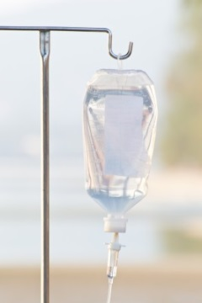
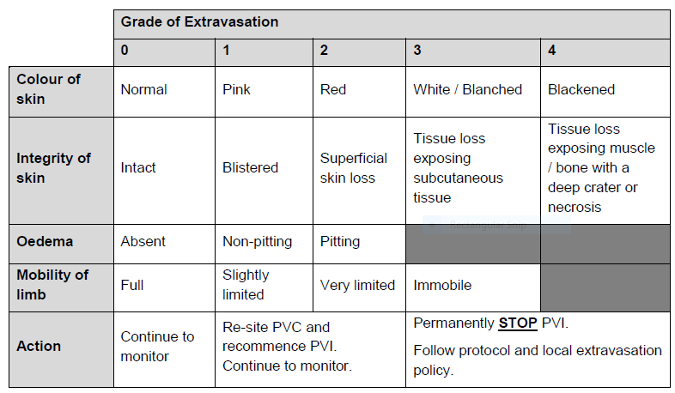
Peripheral norepinephrine: Infusion stopping rules
(Intervention arm)
Peripheral norepinephrine infusion must be immediately and permanently stopped infusion if:
  Systolic BP > 180 mmHg OR
  Diastolic BP > 110 mmHg
  Tachyarrhythmia (ventricular tachycardia or ventricular fibrillation) that is life-threatening
  Suspected local extravasation of IMP if graded severe (Grades 3 or 4) using table
Participant to remain in EVIS study (provided consent is still valid and in place) but protocol directed treatment must stop and the participant managed in line with standard practice
that fails to resolve despite following local treatment protocols
Notes:
23/01/2025
History V1.0 2010
8

Slide 9
Intervention arm: Rescue and maintenance treatments
Rescue IV fluids: If target MAP not reached at maximum norepinephrine dose of 0.15 micrograms/kg/min or clinician concerns of organ hypoperfusion, administer 250-1000ml balanced crystalloid* via peripheral IV route
Maintenance IV fluids: At clinician discretion, maintenance rather than resuscitation IV fluid can be at a rate of no more than 125 ml/hour
Rescue vasopressors: If target MAP not reached using maximum permitted dose and use of rescue IV fluids/concerns of organ hypoperfusion, then rescue vasopressor can be administered via a CENTRAL route. PERMANENTLY STOP peripheral norepinephrine infusion
For operative intervention: Maintain treatment allocation where possible. Anaesthetist discretion permitted for other fluids, blood product and vasopressor use
  * Compound sodium lactate or Plasma-lyte 148 solutions
!
Notes:
23/01/2025
History V1.0 2010
9

Slide 10
Usual care (Control) arm IMPs

Slide 11
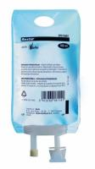
Usual care (Control Arm)
The following balanced crystalloids are permitted:
  Compound sodium lactate solution for infusion.
  (Also known as Ringers lactate solution or Hartmann’s)
  Plasma-lyte® 148 (pH 7.4) solution for infusion
Route of administration: peripheral venous cannula
Initial treatment: Fluid resuscitation titrated to target MAP ≥ 65 mmHg.
  Anticipate most patients will receive approximately 30ml/kg balanced crystalloid in the first 3 hours using 250-1000ml administered by rapid infusion
Ongoing treatment (up to 45 hours post-randomisation): Further balanced crystalloid boluses for resuscitation titrated to target MAP ≥ 65 mmHg
Notes:
23/01/2025
History V1.0 2010
11

Slide 12
Usual care: Rescue and maintenance treatments
The following are permitted:
  Rescue vasopressors: Rescue vasopressor of clinician choice administered via a central line
  Participants should not receive any peripheral vasopressor infusion during the 48 hour study period even where peripheral administration is accepted practice at site
  Maintenance IV fluids: Defined as any fluid at a rate of ≤125ml/hour
  Requirement for operative intervention: Maintain treatment allocation where possible. Anaesthetist discretion permitted for other fluids, blood product and vasopressor use
!
Notes:
23/01/2025
History V1.0 2010
12

Slide 13
Prescribing points & next steps

Slide 14
IMP Prescribing (1)
Only those trained and delegated prescribing responsibilities by the Principal Investigator on the site delegation log may initiate and prescribe EVIS Investigational Medicinal Products (IMPs)
WHY? To minimise potential risks that can occur if untrained staff prescribe study medicines
Intervention Arm: Must be prescribed by trained investigator.
Write prescription to allow dosing in line with protocol requirements that allows infusion to be temporarily stopped or reinstated as per protocol until the end of the 48 hour treatment period.
Prescribing for peripheral IV norepinephrine infusion must be clear and unambiguous
Subsequent prescriptions for control arm:
Balanced crystalloids are used in accordance with routine care so if necessary, subsequent prescriptions can be prescribed by treating clinicians as per usual practice
Notes:
23/01/2025
History V1.0 2010
14

Slide 15
IMP Prescribing (2)
Other prescribing reminders
  IMPs must be prescribed as per routine practice at site OR in accordance with local EVIS processes
  Must be clear that patient is participating in the EVIS Clinical Trial
  Norepinephrine and noradrenaline are both British Approved Names – be consistent and prescribe in terms least likely to cause confusion
  In the event an EVIS patient moves from one clinical area to another with different prescribing systems then acceptable for IMP prescription to be transcribed by someone other than trained investigator. However this should be clearly documented and performed in accordance with local procedures
  Norepinephrine doses in EVIS are expressed solely in terms of norepinephrine base
Notes:
23/01/2025
History V1.0 2010
15

Slide 16
Next steps
Record your training on the EVIS Training Log
Want to know more:
Ask your local EVIS research team
Study website www.evis.scot.nhs.uk (or scan the QRS code)
  Study protocol
  Associated documents
  Training modules can be found on the EVIS website

