Slide 1




EVIS Study Medicines:
Preparation & Administration
EVIS Training Module
Version: 3.0 23.01.2025
Study: EVIS – Early Vasopressors in Sepsis EudraCT: 2021-006886-39
Chief Investigator: Dr Alasdair Corfield Sponsor: NHS Greater Glasgow & Clyde
Warning: This training module is version controlled. Printed or download copies may not be the current version. See www.evis.scot.nhs.uk

Slide 2
Who should view this module?
Aim: To provide detailed information on preparation and administration of EVIS study medicines
Target audience:
  Investigators and research nursing staff delegated IMP preparation and administration related responsibilities on the site delegation log
  Other staff who will prepare and administer EVIS study medicines

Slide 3
Intervention Arm:
Peripheral norepinephrine

Slide 4
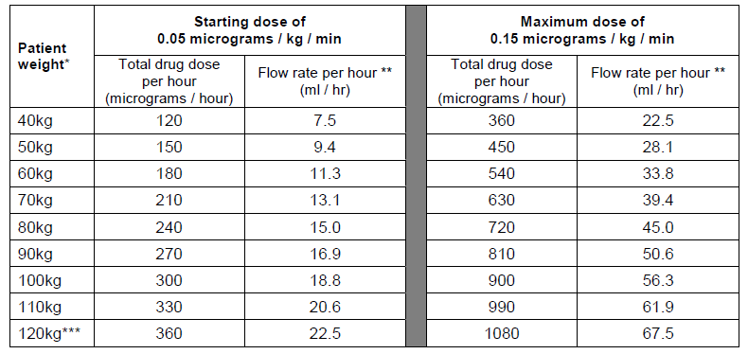
Peripheral norepinephrine: Dose table
(Intervention arm: assuming final norepinephrine concentration of 16 micrograms/ml)
  Norepinephrine dose: Target to MAP ≥ 65 mmHg
Key:
* Round to nearest 10 kg for dosing
* * Round to nearest whole ml if pumps cannot accommodate 1 decimal place
* * * Calculate to exact kg for weights above 120kg. Further information in protocol.
Notes:
04/02/2025
History V1.0 2010
4

Slide 5
Peripheral norepinephrine: Dosing info
(Intervention arm)
Study treatment duration: Up to 48 hours from time of randomisation
Route of administration: peripheral venous cannula
Preparation: solution containing norepinephrine 16 micrograms/ml
Diluent: 0.9% sodium chloride or 5% glucose
Other peripheral vasopressors: Patients in this arm should not receive any other peripheral vasopressor infusion during the 48 hour treatment duration
Dose up and down up-titrations
  Guidance in protocol but check with research team as local policy can be used
  If target MAP ≥ 65mmHg achieved immediately post-randomisation initial infusion rate must be zero. Rate can be increased at any point during 48 hour study period.
Notes:
04/02/2025
History V1.0 2010
5

Slide 6
Peripheral norepinephrine: Dosing
(Intervention arm)
Dose up-titration guidance
  If MAP < 65 mmHg within 15 mins of infusion starting, ↑ infusion rate to maximum of 0.10 micrograms/kg/min
  Reassess after 15 minutes. If MAP < 65mmHg then ↑ infusion rate incrementally to max 0.15 micrograms/kg/min
  If MAP <65 mmHg after 15 minutes at 0.15 micrograms/kg/min consider rescue IV fluids and discuss further treatment escalation with senior medical staff
Dose down-titration guidance
  If MAP > 80mmHg for > 60 mins at 0.15 micrograms/kg/min consider down-titration and ↓ infusion rate to 0.10 micrograms/kg/min
  Reassess after 30 minutes. If MAP > 80mmHg then ↓ infusion rate to 0.05 micrograms/kg/min
  Reassess after 30 minutes.
    If MAP > 80mmHg titrate infusion rate down incrementally and STOP
    If MAP remains > 65mmgHg and < 80mmHg adjust the infusion rate at treating clinician discretion
Notes:
04/02/2025
History V1.0 2010
6

Slide 7
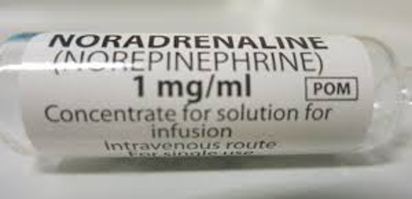
Peripheral norepinephrine: Preparation (1)
(Intervention arm)
Preparation: Must use Norepinephrine 1mg/ml concentrate for solution for infusion
Concentration: Prepared infusion should contain Norepinephrine 16 micrograms/ml
Expiry: Assign as per SmPC/local practice
To prepare 250ml infusion containing norepinephrine 16 micrograms/ml
1 x 4ml ampoule norepinephrine 1mg/ml concentrate for solution for infusion
1 x 250ml infusion bag of 5% glucose or 0.9% sodium chloride
To prepare 500ml infusion containing norepinephrine 16 micrograms/ml
1 x 8ml ampoule norepinephrine 1mg/ml concentrate for solution for infusion
1 x 500ml infusion bag of 5% glucose or 0.9% sodium chloride
Notes:
04/02/2025
History V1.0 2010
7

Slide 8
Peripheral norepinephrine: Preparation (2)
(Intervention arm)
Method Withdraw volume of diluent from infusion bag equal to the volume of norepinephrine solution that will be added (4ml or 8ml) and then discard. Draw up contents of one ampoule (4ml or 8ml) of norepinephrine 1 mg/ml concentrate for solution for infusion and add to the infusion bag. Mix thoroughly and inspect. Do not use if solution it is discoloured or contains precipitate. Label infusion bag as per standard practice. Apply EVIS study label (optional)
Other useful information
  There are no study specific supplies for EVIS – use hospital own stock
  Stickers available to help identify patients (optional use)
  Follow usual practice at site with regards to preparation checks
Notes:
04/02/2025
History V1.0 2010
8

Slide 9
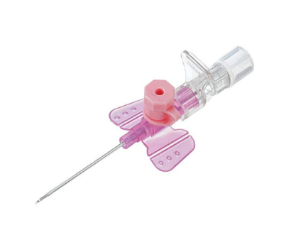
Peripheral norepinephrine: Administration (1)
(Intervention arm)
An infusion pump must be used
Siting the PVC
  Use at least a 20G PVC size
  Locate as per standard practice at site. Peripheral long lines acceptable provided standard at site
  Avoid sites of flexion in awake patient (risk of occlusion) and sites requiring > 1 venepuncture
  Ensure:
    there is a return of blood following insertion
    PVC flushes easily with 5-10 ml of 0.9% sodium chloride
  Consider use of ultrasound
Notes:
04/02/2025
History V1.0 2010
9

Slide 10
Peripheral norepinephrine: Administration (2)
(Intervention arm)
Key points for safe administration
  Do not allow the hung infusion to completely run through and end
    Why? Norepinephrine has a very short half-life and abrupt discontinuation without weaning is likely to have deleterious effect on the patient
  After discontinuation flush with sodium chloride 0.9% at the same rate as previous infusion to avoid adverse effects
  Avoid administration of other medicines via Y-site even where there is known compatibility to prevent inadvertent bolus of norepinephrine
Notes:
04/02/2025
History V1.0 2010
10

Slide 11
Peripheral norepinephrine: BP monitoring
(Intervention arm)
Blood pressure monitoring:
  Invasive blood pressure monitoring recommended
  Regular interval non-intensive blood pressure monitoring can be utilised if invasive BP monitoring not available within clinical environment
  Frequency: as per clinical need/standard practice at site
  Document: as per usual practice
Notes:
04/02/2025
History V1.0 2010
11

Slide 12
Peripheral norepinephrine: PVC monitoring
(Intervention arm)
Monitoring of Peripheral Venous Cannula (PVC)
  Hourly (approximately) checks of PVC must be completed.
  Check the infusion site to ensure free flow and to identify early signs of extravasation
  Suggested that PVC check is completed at same time as routine infusion checks
Why?
  One of the perceived concerns around peripheral administration of norephineprine is the risk of extravasation and subsequent tissue necrosis around the vein being used for administration
  Regular monitoring of the PVC is an effective and easy to implement risk mitigation strategy
Notes:
04/02/2025
History V1.0 2010
12

Slide 13
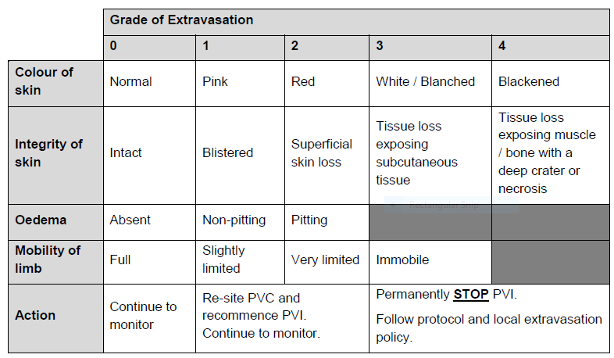
Peripheral norepinephrine: Extravasation (1)
(Intervention arm)
Grade extravasation from 0 – 4
If signs span more than one grade, assign the higher score
Document the grade (required for study data)
Notes:
04/02/2025
History V1.0 2010
13

Slide 14
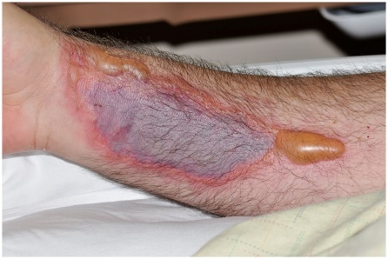
Peripheral norepinephrine: Extravasation (2)
(Intervention arm)
Suspect extravasation if the patient reports:
  Pain or itching at the infusion site
  Oedema, pallor (skin is paler) or erythema (redness) of skin at the cannula site
Recommended actions or follow local extravasation policy:
  STOP the infusion immediately and disconnect the line from the PVC
  Attempt to aspirate 3-5ml from the PVC if able
  Remove the PVC, apply a dressing, elevate and mark the extravasation area
  Consider: topical vasoactive to encourage local blood flow eg. nitroglycerin paste
  Give analgesia if required
  Seek advice from surgeon/tissue viability service if concerned
Notes:
04/02/2025
History V1.0 2010
14

Slide 15
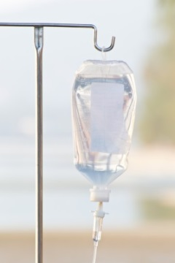
Peripheral norepinephrine: Infusion stopping rules
(Intervention arm)
Peripheral norepinephrine infusion must be immediately and permanently stopped infusion if:
  Systolic BP > 180 mmHg OR
  Diastolic BP > 110 mmHg
  Tachyarrhythmia (ventricular tachycardia or ventricular fibrillation) that is life-threatening
  Suspected local extravasation of IMP if graded severe (Grade 3 or 4)
Participant to remain in EVIS study (provided consent is still valid and in place) but protocol directed treatment must stop and the participant managed in line with standard practice
that fails to resolve despite following local treatment protocols
Notes:
04/02/2025
History V1.0 2010
15

Slide 16
Usual care (Control) arm IMPs

Slide 17
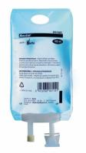
Usual care (Control Arm)
The following balanced crystalloids are permitted:
  Compound sodium lactate solution for infusion.
  (Also known as Ringers lactate solution or Hartmann’s)
  Plasma-lyte® 148 (pH 7.4) solution for infusion
Route of administration: peripheral venous cannula
Initial treatment: Fluid resuscitation titrated to target MAP ≥ 65 mmHg.
  Anticipate most patients will receive approximately 30ml/kg balanced crystalloid in the first 3 hours using 250-1000ml administered by rapid infusion
Ongoing treatment (up to 45 hours post-randomisation): Further balanced crystalloid boluses for resuscitation titrated to target MAP ≥ 65 mmHg
Notes:
04/02/2025
History V1.0 2010
17

Slide 18
Usual care (Control Arm)
Other information
  There are no study specific supplies for EVIS – use hospital own stock
  Stickers (optional) are available to highlight control EVIS patients
Notes:
04/02/2025
History V1.0 2010
18

Slide 19
Prescribing & Documentation

Slide 20
IMP Prescribing
Only those who have been trained and delegated prescribing responsibilities by the Principal Investigator on the site delegation log may prescribe EVIS Investigational Medicinal Products (IMPs)
Check that norepinephrine or balanced crystalloids have been prescribed
Should be clear on prescription that patient is taking part in EVIS study
Double check if patient is transferred from one clinical area to another where different prescribing systems are used eg. electronic versus paper prescription
Check electronic prescribing notes for additional information
Ask research or senior medical staff if unsure
Notes:
04/02/2025
History V1.0 2010
20

Slide 21
EVIS documentation
(Intervention & Usual care Arms)
Important for validity of study results that data is as accurate and complete as possible particularly the following:
  All dose changes/infusion rate changes
  Time infusion was started, stopped, or the flow rate changed
  Time of temporary and permanent treatment discontinuation
  Patient weight (kg) Estimated weights can be used
  Other fluids administered eg. albumin etc
Check how data will be recorded at your site for each arm
  Study specific documentation for intervention requirements
  Routine documentation eg. infusion chart, fluid balance chart
Notes:
04/02/2025
History V1.0 2010
21

Slide 22
Support for staff
(Intervention & Usual care Arms)
At the bedside - Clinical Information Sheets
  Separate sheets for Intervention and Usual Care arms.
  Contain summary information on permitted rescue and maintenance treatments, time of randomisation and local study team contact details.
  Also provide information tailored to each arm on administration eg. invention arm document contains dose calculation and preparation information and infusion stopping rules
  Inserted to participant’s medical records at time of randomisation by research team
  Includes contact for research team
EVIS website
  www.evis.scot.nhs.uk
Notes:
04/02/2025
History V1.0 2010
22

Slide 23
Next steps
Record your training on the EVIS Training Log
Want to know more:
Ask your local EVIS research team
Study website www.evis.scot.nhs.uk (or scan the QRS code)
  Study protocol
  Associated documents
  Training modules can be found on the EVIS website

