Slide 1



Good Research Practice/ GCP Awareness for EVIS
EVIS Training Module 10
22/01/2026
Study: EVIS – Early Vasopressors in Sepsis EudraCT: 2021-006886-39
Chief Investigator: Dr Alasdair Corfield Sponsor: NHS Greater Glasgow & Clyde

Slide 2

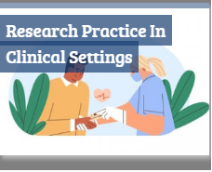
NIHR Research Practice in Clinical Settings
1. Users will require a NIHR Learn account
2. Then click on the GCP and Research Delivery E-learning Hub icon
3. Then select Research Practice in Clinical Settings

Slide 3
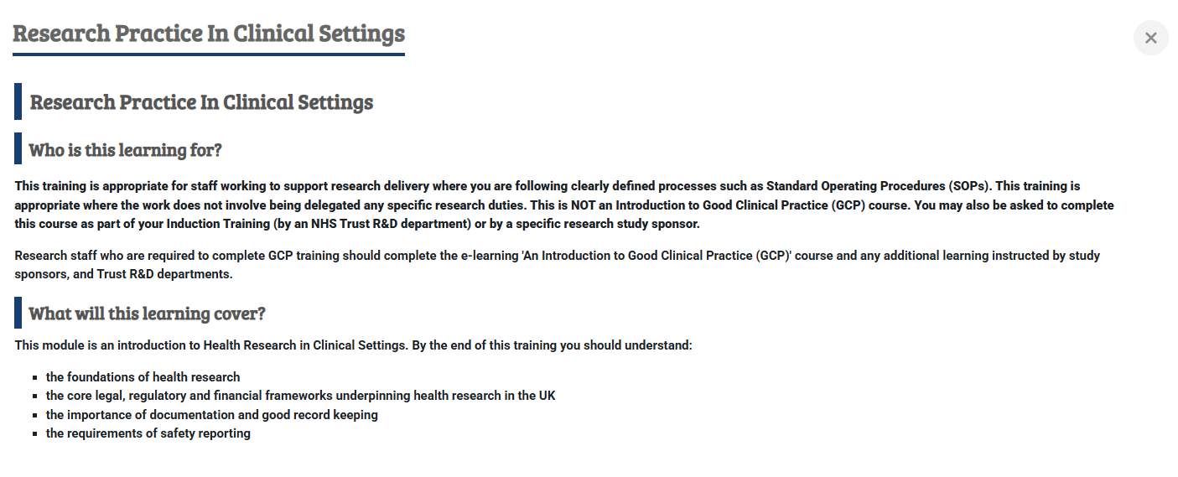
NIHR Research Practice in Clinical Settings
The course content at the current time (Jan 2026) is as follows:

Slide 4
Next steps
Record your training on the EVIS Training Log
See EVIS Training Matrix for additional training modules
Want to know more:
Ask your local EVIS research team
Study website www.evis.scot.nhs.uk (or scan the QRS code)
Study protocol
Associated documents
Training matrix (mandatory & recommended)
Training modules

