Slide 1


EVIS FAQs
Contacts
CI: Alasdair Corfield (Alasdair.Corfield2@nhs.scot)
Trial manager: Hannah Greenwood (Hannah.Greenwood@nhs.scot)
Email: ggc.evistrial@nhs.scot
X: @evis_trial
Research Nurse Contact – EMERGE: loth.emerge2@nhs.scot
Version 5
Last Updated: 23.01.2025

Slide 2
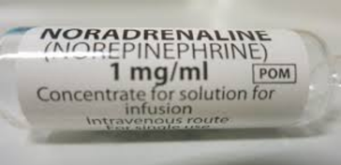
Concentration for NE infusion
Intervention Arm
Norepinephrine should be prepared and delivered at a concentration of 16 micrograms/ml*
Norepinephrine is 1mg/1ml concentrate for solution
Using a 250ml infusion bag use 1 x 4ml*
Using a 500ml infusion bag use 1 x 8ml*
Please see IMP manual or Peripheral Norepinephrine Preparation and Administration Record.

Slide 3
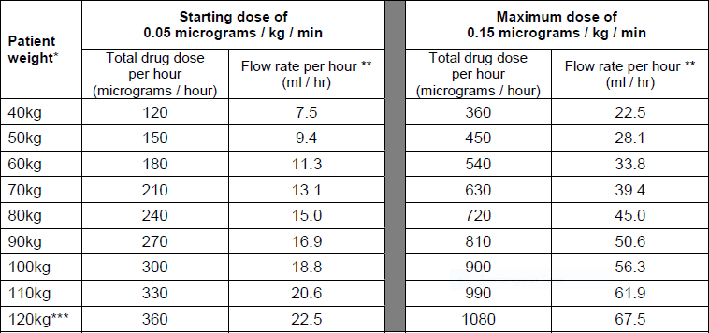
Dosing/flow rate for NE infusion
Intervention Arm
Please follow local policy or see the guidance
in Appendix A and guidance on preparation and administration form
The starting dose of the infusion is 0.05micrograms/kg/min –
For example for a 70kg patient this will be calculated as follows:
0.05 (starting dose) x 70kg = 3.5 micrograms per minute
3.5micrograms x 60 (minutes) = 210 micrograms per hour which is a flow rate of 13.1ml/hr

Slide 4
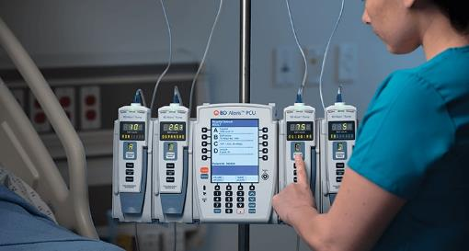
Titration
Dose up – Titration for Peripheral Vasopressor Infusion
Use local policy if available
Commence Norepinephrine at 0.05 micrograms/kg/min based on rounded weight in dosing guide table from Appendix A in protocol.
Aim for MAP ≥ 65mmHg
(PLEASE NOTE: TARGET MAP IS GREATER THAN OR EQUAL TO 65)
Norepinephrine dose may be increased in increments of 0.05 micrograms or at investigator discretion to achieve a target MAP ≥ 65 mmHg
The maximum dose of norepinephrine is 0.15 micrograms/kg/min

Slide 5
Titration
Dose down – Titration for Peripheral Vasopressor Infusion
Use local policy if available
If MAP is greater than 80mmHg for a sustained period of greater than 1 hour, consider down titration of PVI and then reassess.
The infusion may be decreased in increments of
0.05 micrograms/kg/min or as clinically indicated to achieve the target MAP with reassessment.
Guidance is provided in Appendix A of the study protocol

Slide 6
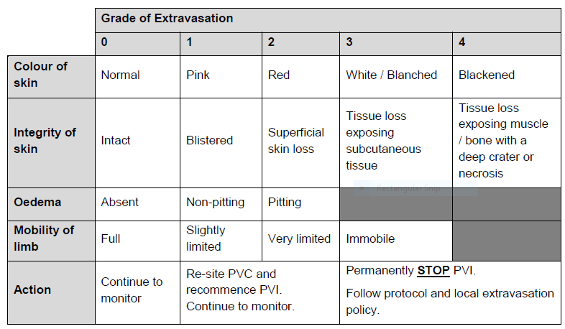
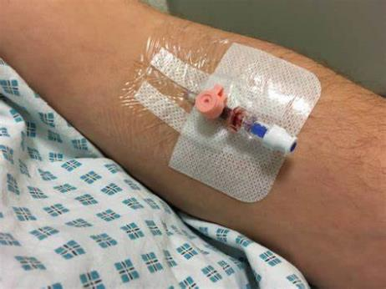
Dealing with suspected extravasation of Norepinephrine (1)
Extravasation is a rare complication of Norepinephrine peripheral infusion
Monitor, the infusion site on an hourly basis. Document the grade of extravasation using this table.

Slide 7
Dealing with suspected extravasation of Norepinephrine (2)
Extravasation is a rare complication of Norepinephrine peripheral infusion
If extravasation is suspected or the patient reports sustained pain at the infusion site then take the following actions:
Grades 1 or 2:
Re-site the cannula and continue the norepinephrine infusion
Grades 3 or 4:
Stop the infusion and disconnect the infusion line from the cannula.
Follow the step by step guidance heard in the voiceover or follow any local extravasation policy.
Inform research team and continue to manage as per policy.
Participant’s treatment should revert back to usual care at site.

Slide 8
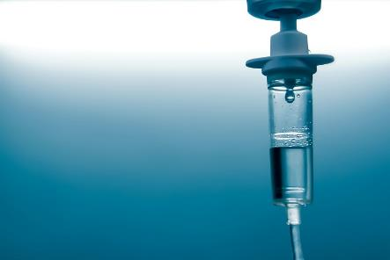
Recording IV fluids accurately
Patients in both arms of the study will receive intravenous fluids
Intervention arm – if target MAP not reached once maximum titrated dose of
0.15 micrograms/kg/min has been reached or clinician concerns of organ
hypo perfusion, then resuscitation IV fluids 250-1000mls boluses of balanced
crystalloid can be administrated.
Maintenance fluids can be given once resuscitation fluids are complete, at a
Rate no more than 125ml/hour.
The volume of IV fluids is valuable data that the research team will collect
From randomisation to 72 hours.
Please ensure fluid balance charts are completed and volume of fluid is
documented accurately.

Slide 9
Recording IV fluids accurately
Control arm - Participants allocated to the control arm will receive standard
care as defined by the UK NICE guidelines and the Surviving Sepsis Campaign
Guidelines during the 48 hour study period post randomisation.
Maintenance fluids can be given once resuscitation fluids are complete, at a
Rate no more than 125ml/hour.
The volume of IV fluids is valuable data that the research team will collect
From randomisation to 72 hours.
Please ensure fluid balance charts are completed and volume of fluid is
documented accurately.

Slide 10
Recording start stop times for Norepinephrine infusion correctly
Important for study data that flow rates and infusion start and stop times for
peripheral norepinephrine are accurately recorded.
A template Peripheral norepinephrine Preparation & Administration Record is
available but check with research team what is being used at your site

